Slide 1
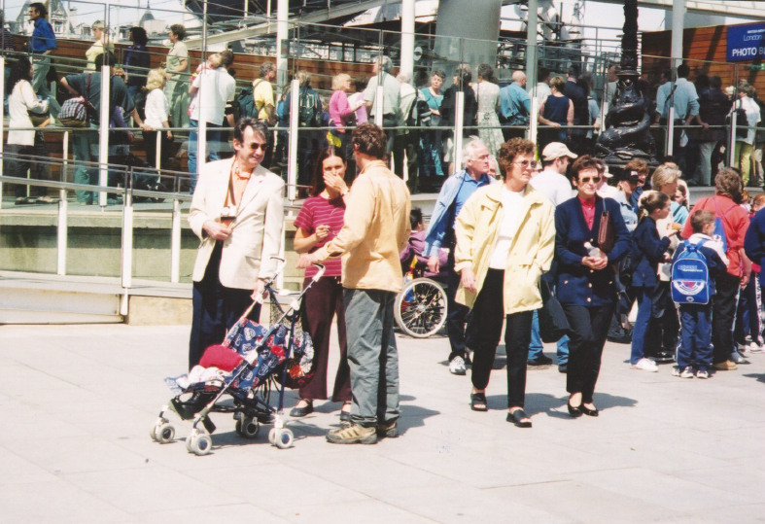
Inclusive Public Toilet Planning: Provision for everyone, all sorts of people, all sorts of needs
Toilets, Public and Social Justice Conference Newport 7th November 2017 Dr Clara Greed, Professor of Urban Planning, UWE, Bristol
1

Slide 2
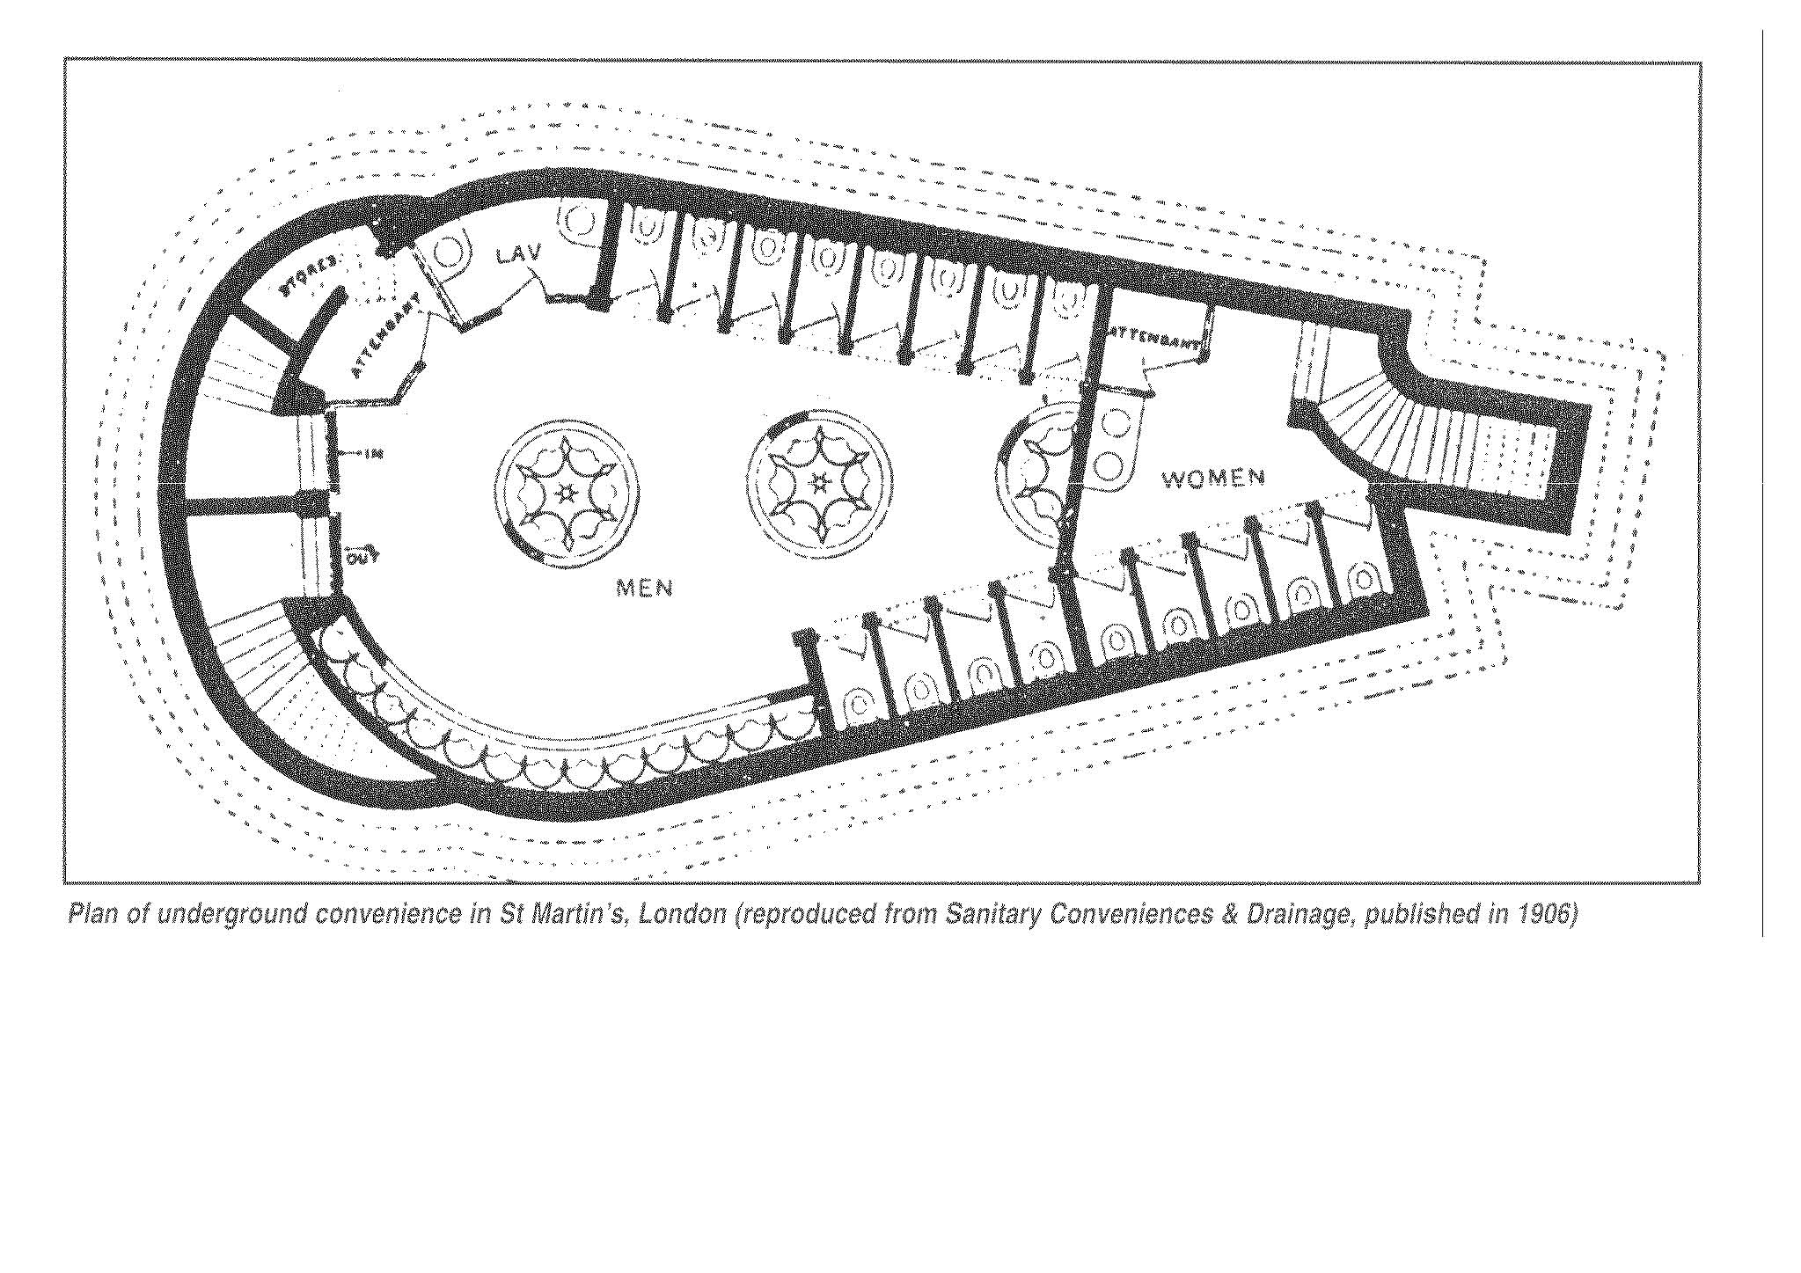
Historically women have had much less provision than men, and today both in the UK and globally women suffer major sanitary discrimination. In spite of years of feminism, ‘if you want to know the true position of women in modern society look at the queue for the loo’. Women’s toilet needs have been seen as secondary, unimportant, and dirtier, relative to men’s, or women and their bodily functions have simply been invisible to policy makers, a source of embarrassment and ‘dirty’ jokes, which are all mechanisms to control women.

Slide 3
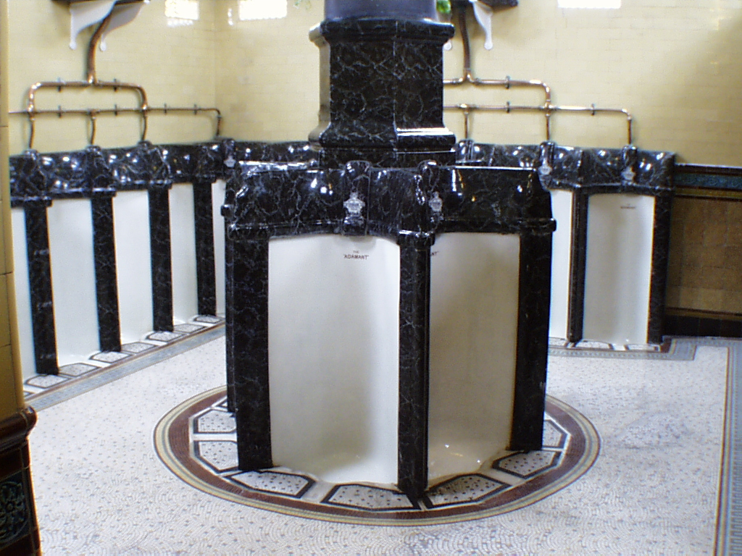
A Heritage of Civic Pride and High-level of toilet provision
But not for women
Notes:
Although we have a strong historical heritage of public toilet building it was mainly for men, designed for men, with women being barely considered

Slide 4
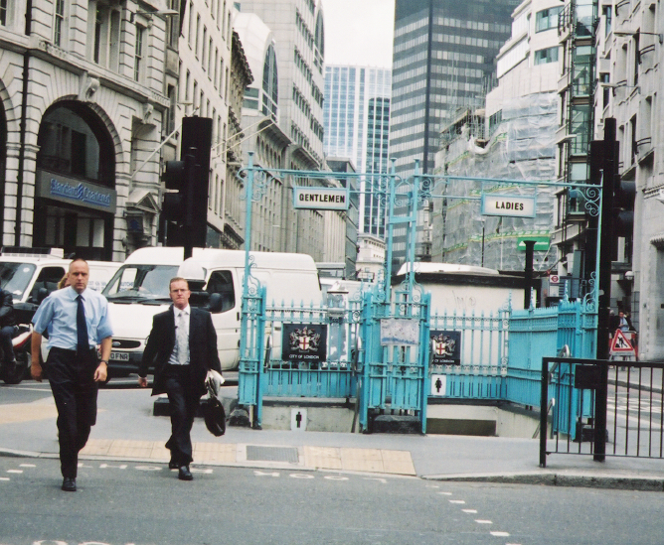
Everyone needs Toilets
But Men and Women’s needs are different

Slide 5
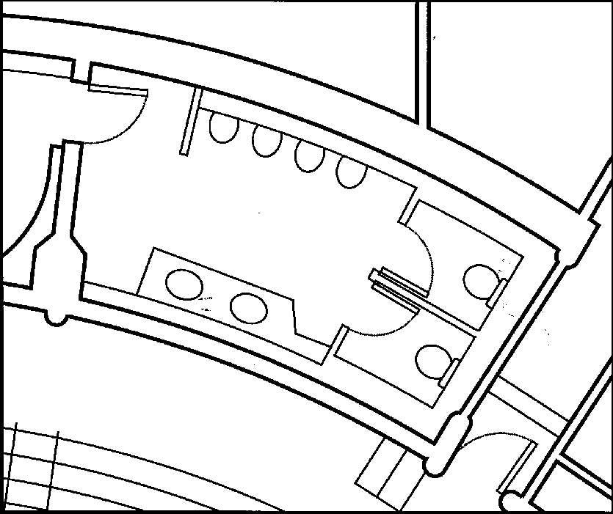
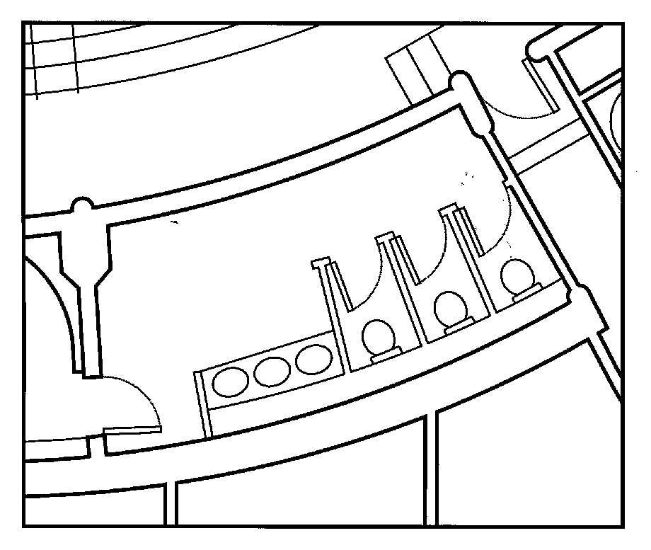
At the opera! Toilets should be designed to provide at least equal provision for women. Good practice is to 2:1 f:m ratio should be provided to avoid queues
But most toilets have almost twice the facilities for men as women because urinals take up less space than cubicles within the same floor area.

Slide 6
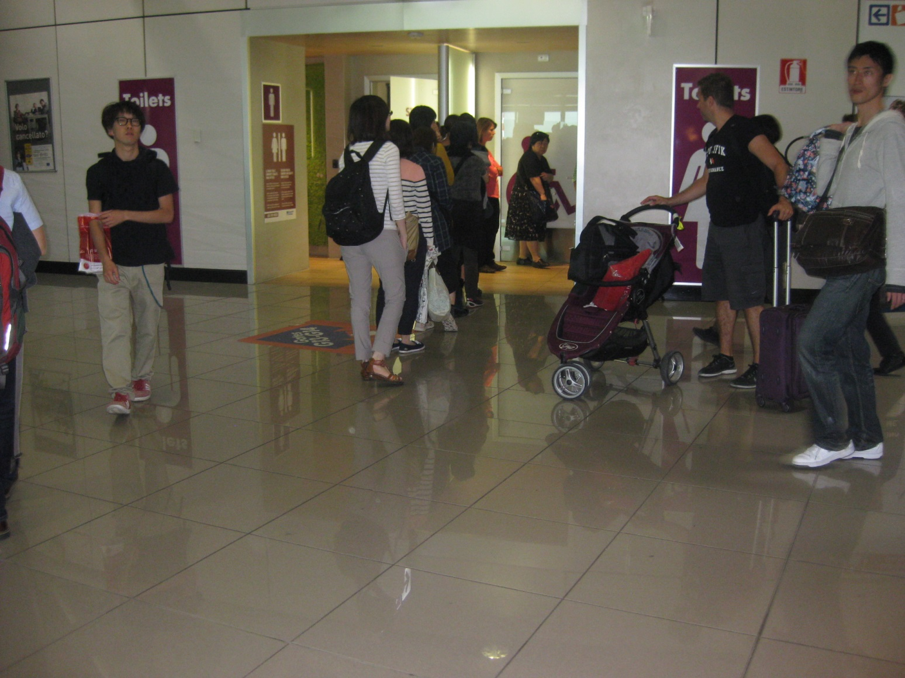
The heritage of unequal provision continues to this day, right across the world, not just in the UK, as manifest in this European airport toilet, a situation replicated across many countries and situations
6

Slide 7
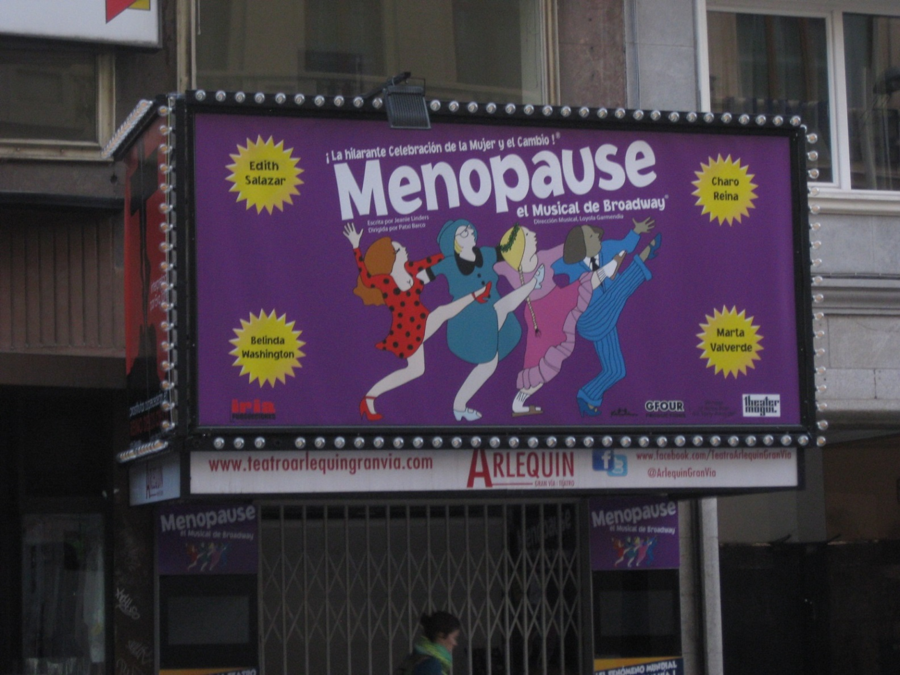
Menopause the Musical, here showing in Madrid, but not in London because Jeanne Linders the writer, producer, and lyricist of the musical would not take it to the West End in protest against the inadequate provision of toilets for women in London theatres because many of her audience are menopausal women in their forties and fifties who need to use the toilet.

Slide 8
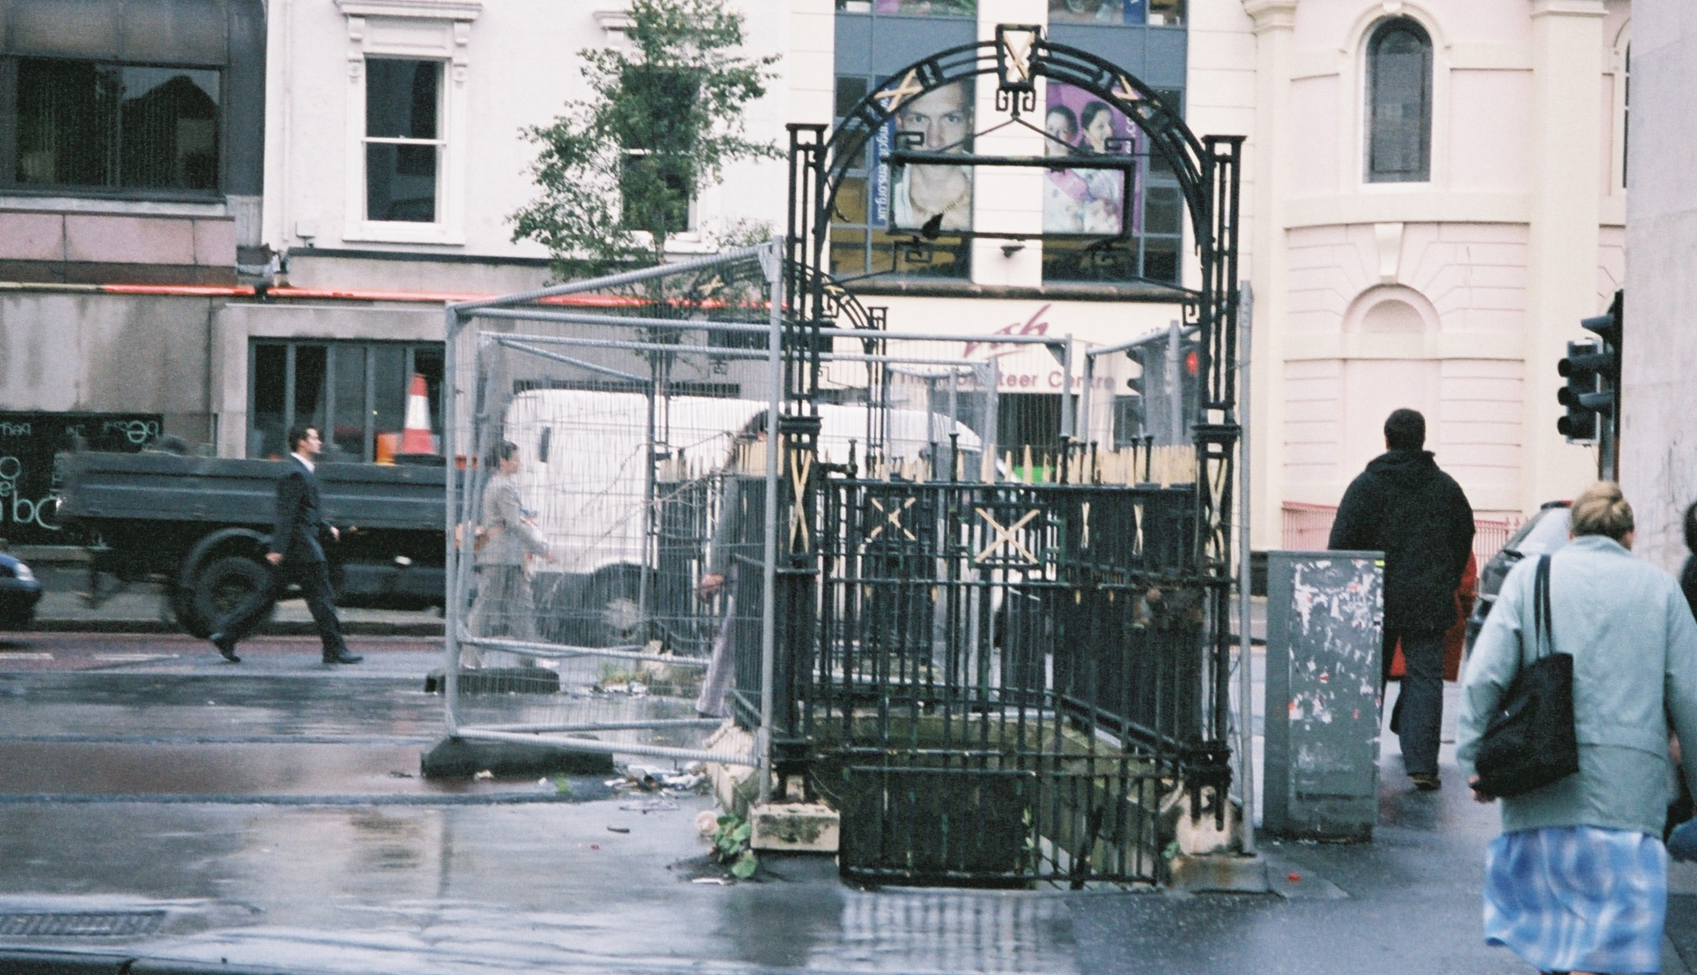
But overall public toilets are declining and reducing daily. Many Victorian public toilets that provided for men and women, albeit often underground are now closing or being left purposely to fall into disrepair, because of government cutbacks and lack of political will. Often there is no alternative except to buy a coffee to use the loo or just not to go out at all.

Slide 9
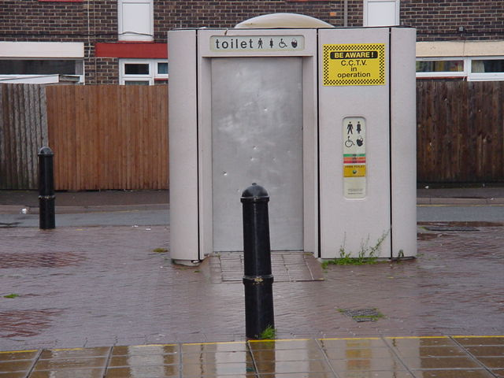
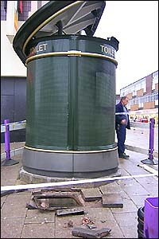
But toilet provision, especially for women is decreasing, but some are being replaced by Automatic public toilets
Unattractive ‘vandal proof’ APC
Exploded APC, Stoke on Trent

Slide 10
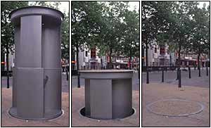
But what do we get instead? The Urilift which comes out at night, and comprises a very public and expensive form of male street provision

Slide 11
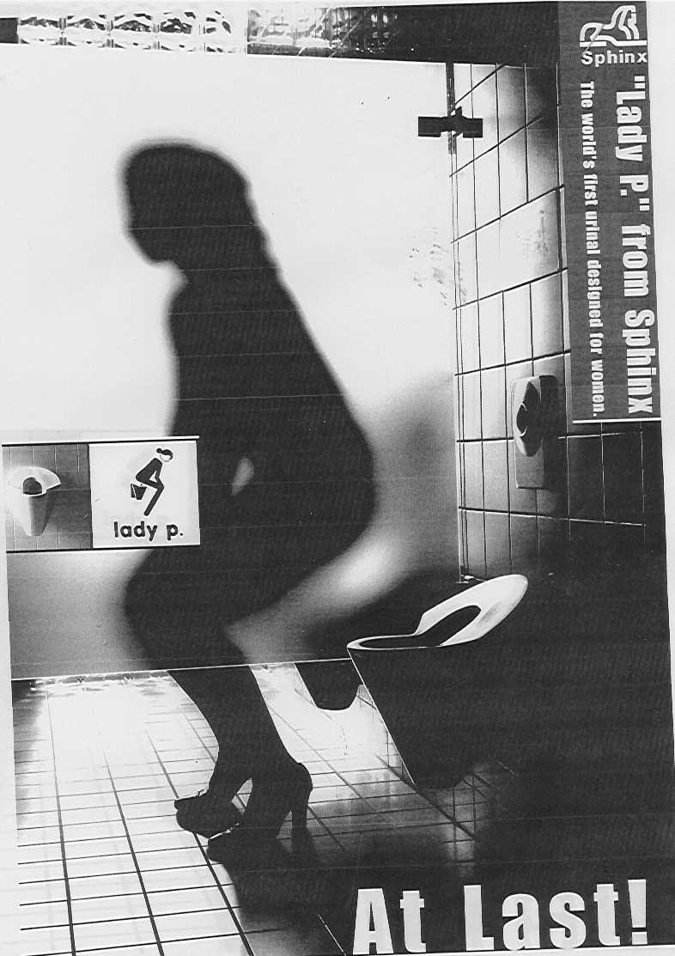
Why can’t a woman be more like a man?
The Lady P female urinal.
Many women are wary of sitting on the toilet seat so they hover or crouch instead. But this is not a good design solution as in the case of the ‘urinette’ as it is causes muscle stress, and is not practical for the elderly, infirm and pregnant. Also very awkward for those menstruating, and not designed for defecation either.

Slide 12
A Turnstile blocking free access to the public toilet in Westminster, London. 50p to use the toilet. Toilet finance, privatisation, franchising, and charging for services are all difficult issues, as toilets are a public service.
Hardly user-friendly in terms of accessibility!

Slide 13
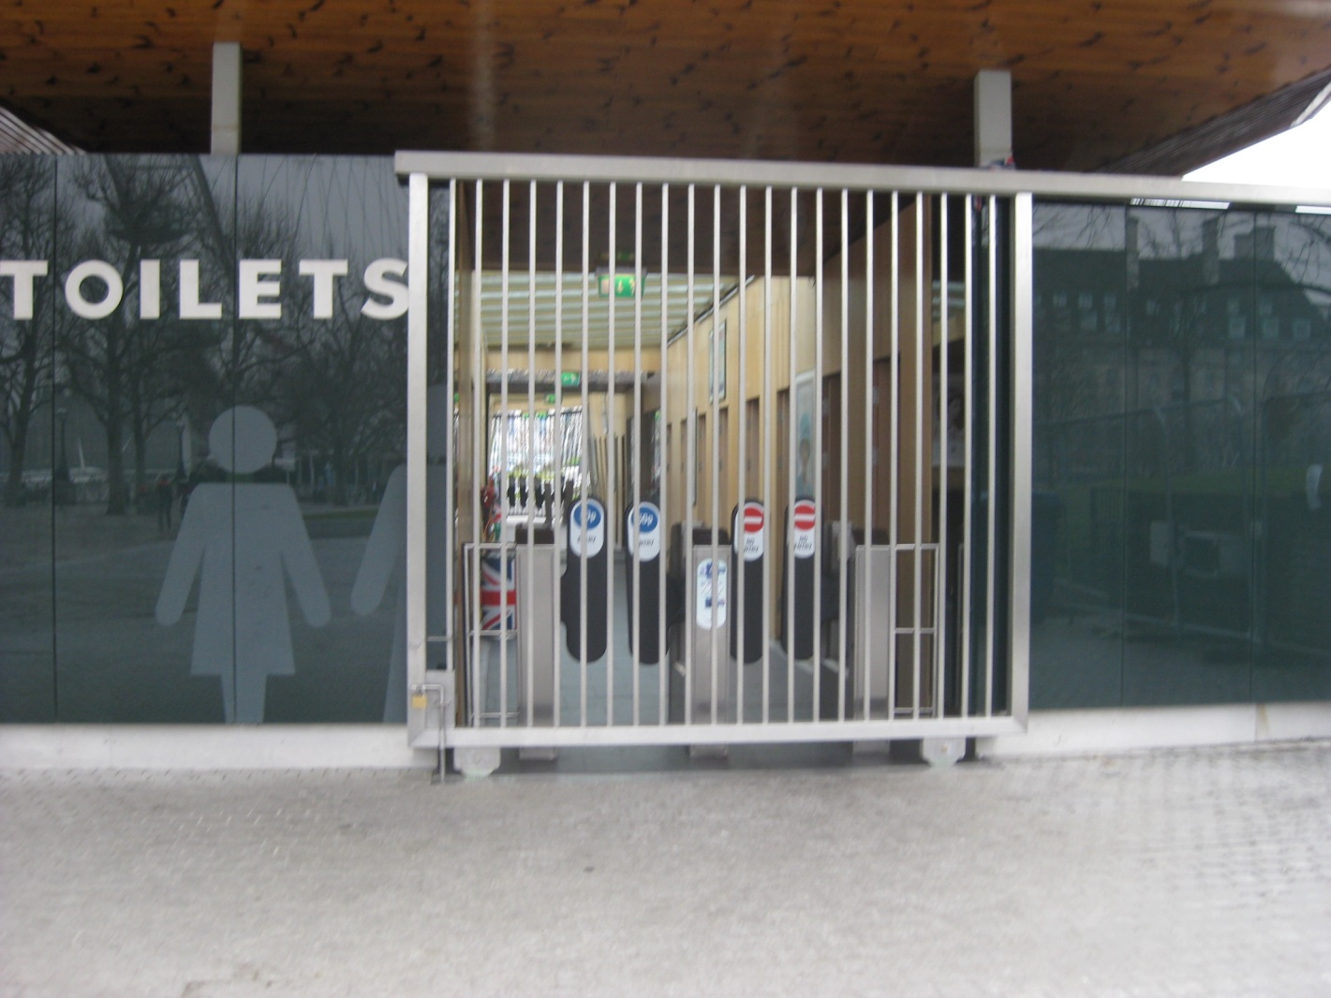
THE JUBILOO, near the London Eye. The 2013 London Local Authorities Act abolishes the restriction (under the 1963 Turnstiles Act) on putting turnstiles at toilet entrances in those public toilets managed by London Borough Councils

Slide 14
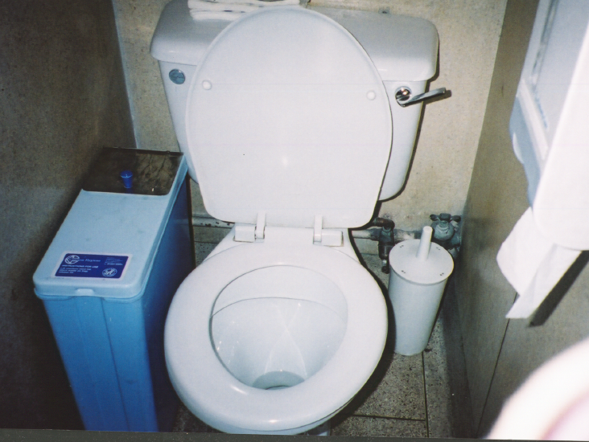
At the detailed user level many were concerned with sanpro bins touching the seat (and thighs) and reducing access in already narrow cubicles. Menstruation is seen as so unimportant that a small plastic bin is wedged between the pan and the wall in what is already a narrow standard cubicle.

Slide 15
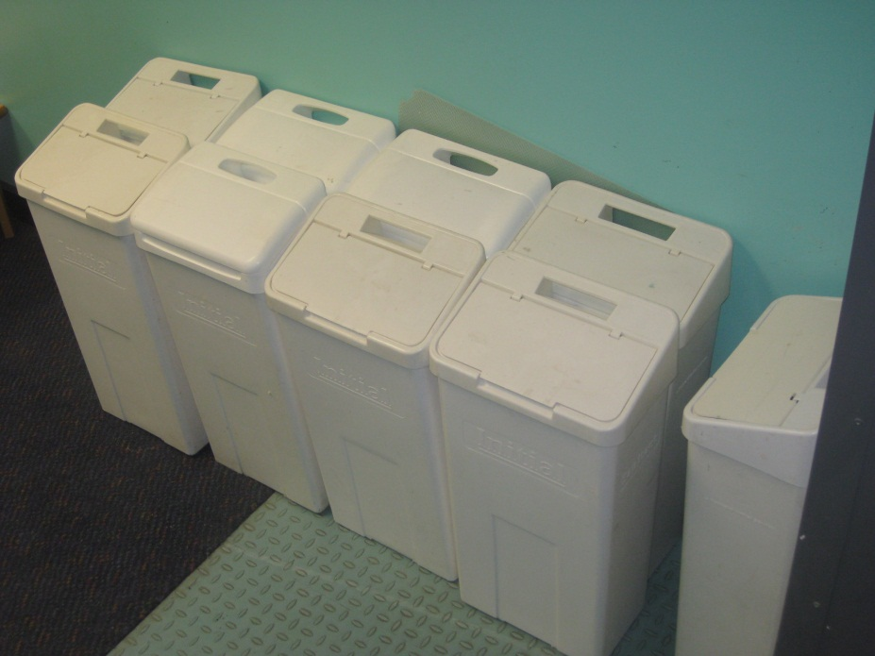
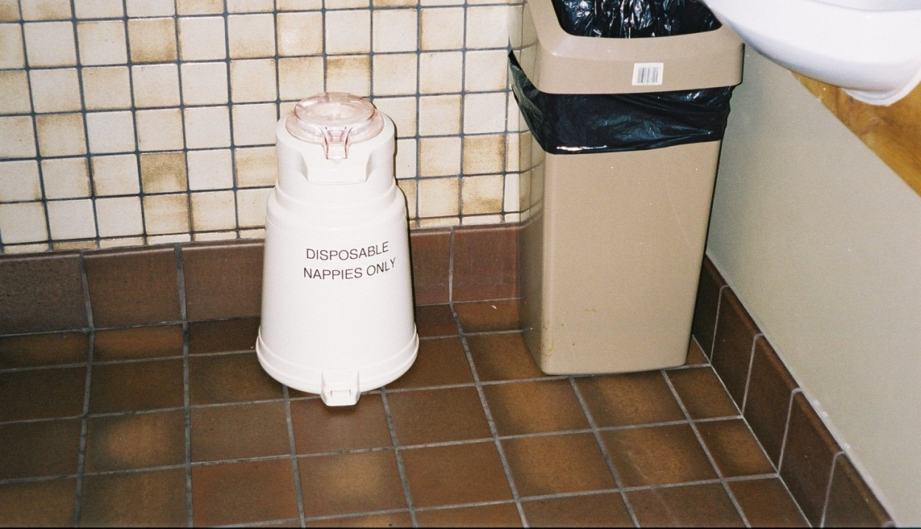
Women are often condemned for creating more waste and harming the environment more than men. But men have created the problem by industrialising, consumerising and commercialising sanitary products. Globally, menstrual pads and tampons are not the solution, as few can afford them, and if everyone in the world used disposable protection, the mountain of sanitary pads would be higher than the disposable nappy mountain! Also Elementary sewage systems cannot cope with tampons and plastic waste
Solutions include, recyclable washable pads and moon cups, along with more female toilets, changing and washing facilities, and more privacy are all needed in both school and work toilets for women. Note women with FGM are unable to use moon cups

Slide 16
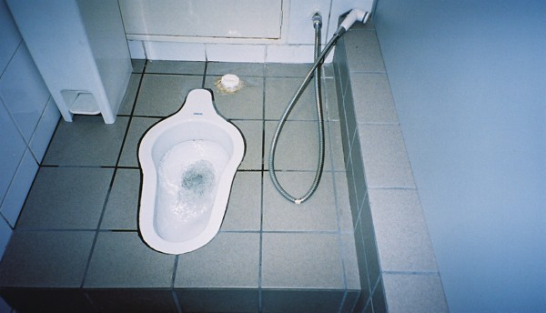
Western toilet solutions are not necessarily the answer. A Moslem style toilet, with no toilet paper, but people use water instead and they squat rather than sit on a seat (that someone else has just sat upon) which is considered more hygienic. The sit/squat and water/paper debates are central to future toilet provision policies.
Water is seen as a purifier, but women in many religions, including Christianity, are seen as dirtier than men, as they fall on the wrong side of the clean/dirty divide, as well as the spirit/body, sacred/profane, spiritual/natural, white/black, public/private, rational/emotional, good/evil, and essential/luxury divides

Slide 17
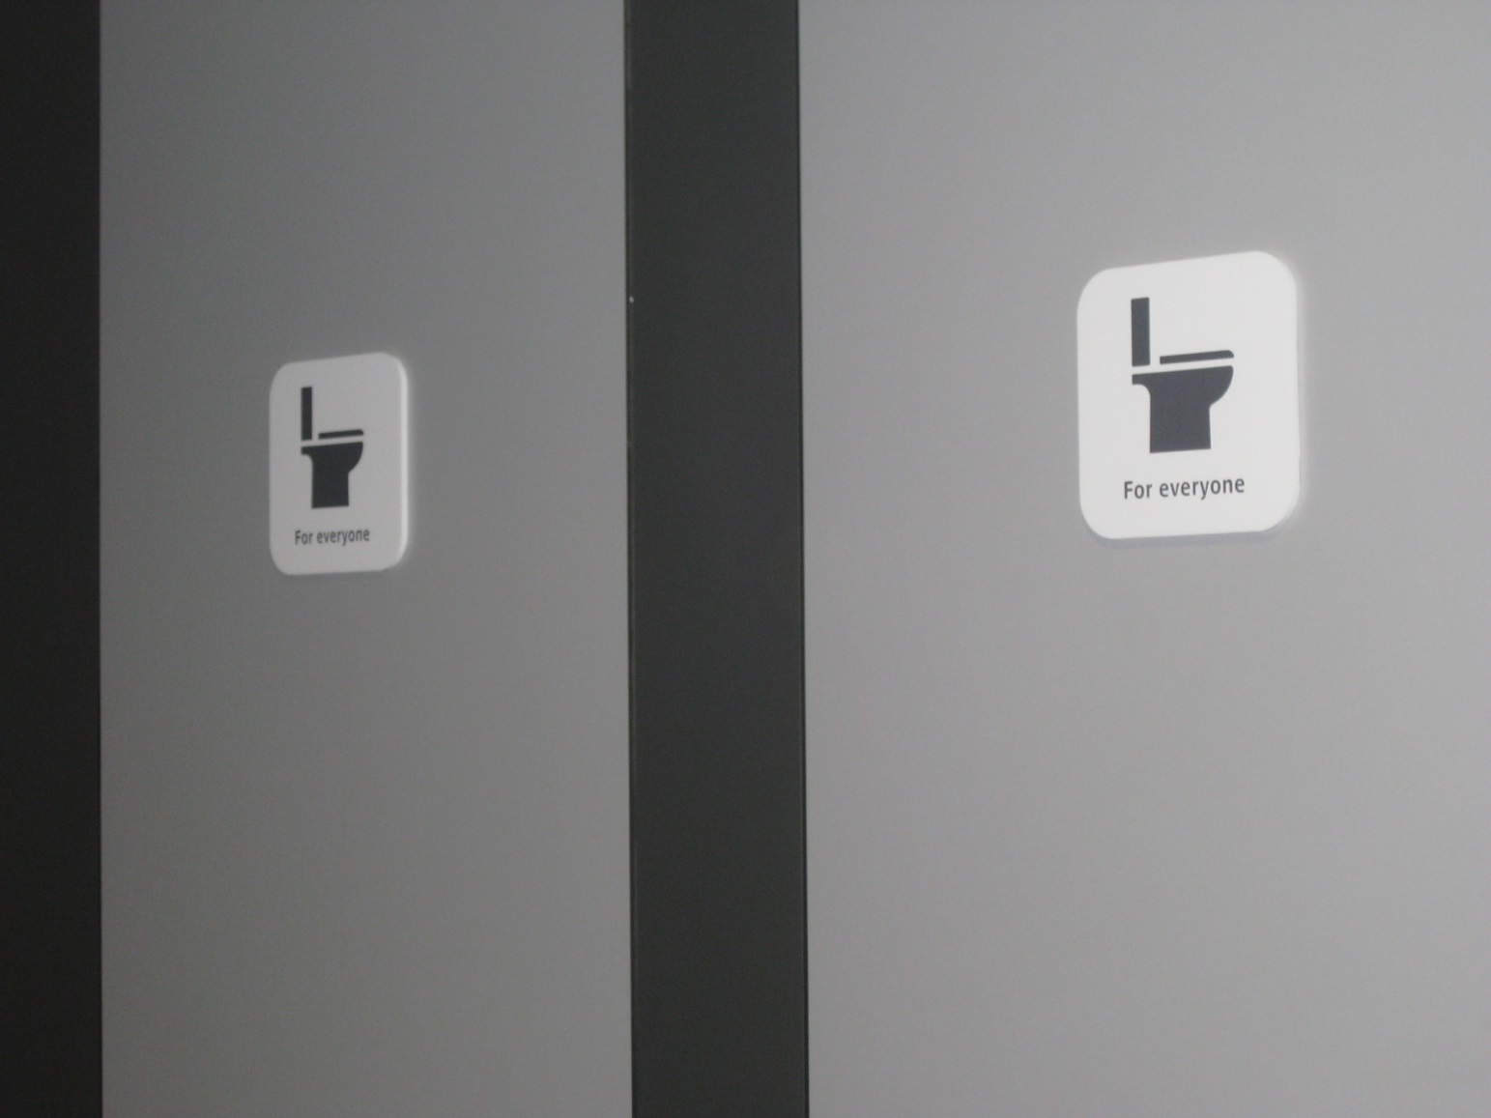
After years of campaigning for more women, we are now confronted with Gender Neutral Toilets? What effect do they have on queuing, the level of provision for women and equality? Gender is now seen as a continuum not a binary male/female division

Slide 18
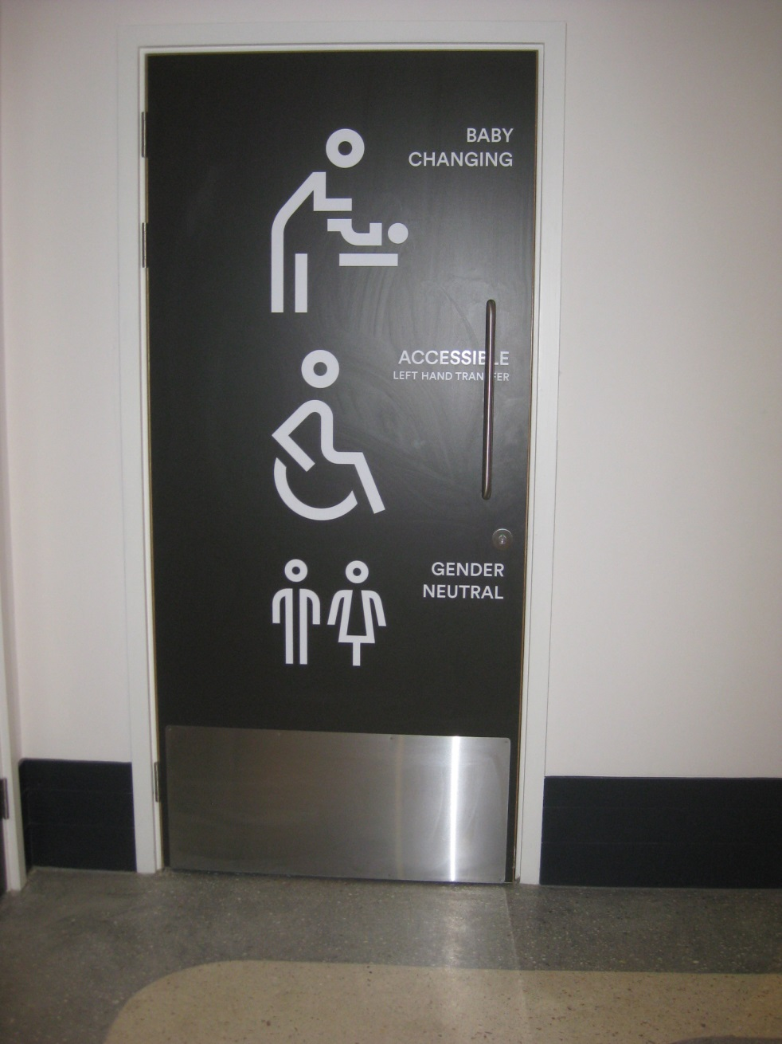
But a wider range of toilet provision is to be welcomed, with other so-called minority toilet user groups also requiring more facilities, including people with disabilities, those with babies and small children
But women who comprise around 30 million people in the UK still do not have adequate toilets, whilst the needs of around 5,000 transgender users (and 200,000 unsure about their gender identity) have been prioritised
( from the new Chester
Story House Arts Centre)

Slide 19
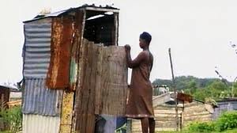
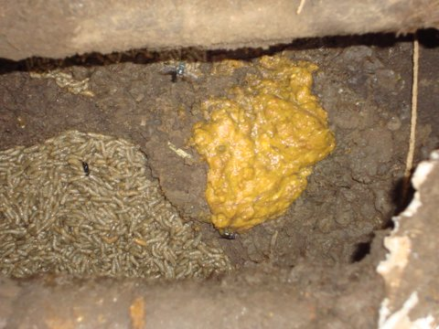
Globally out of 7 billion total world population, over 2 billion lack basic access to water, sanitation, electricity and of course toilets
There are more mobile phones in the world than there are toilets.
50% of the world’s people is urban now but a third of them live in shanty towns
(Photo courtesy of Marion Loft, Dutch toilet expert)

Slide 20
GLOBAL SUSTAINABILITY PERSPECTIVES
The original definition of sustainability included environmental sustainability, plus social equality (including gender), health, well-being and economic viability (UN, 1992) that is Place, People and Prosperity. The United Nations Millennium Development Goals (MDGs), http://www.un.org/millenniumgoals/ introduced in 2000, were eight in number and most had gender and sanitation implications, such as 3. Promote gender equality and empower women and 7 ‘Ensure environmental sustainability’, especially 7c, ‘halve, by 2015, the proportion of people without sustainable access to safe drinking water and basic sanitation’.
The MDGs were replaced by the Sustainable Development Goals (SDGs) http://www.isdgs.org/ in which Target 6 links sanitation and gender issues. Subsection 6.2 states that by 2030 the aim is ‘to achieve access to adequate and equitable sanitation and hygiene for all and to end open defecation, paying special attention to the needs of women and girls and those in vulnerable situations’. But no mention is made of menstruation, or the differences between women’s and men’s needs.

Slide 21

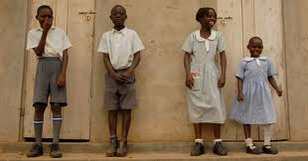
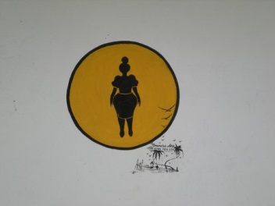
Girls and Women’s needs are different from boys and men’s needs. This is particularly so in the case of school toilets where there may be no privacy, shared facilities or very inadequate provision for girls. But women’s needs have often been ‘invisible’ to male sanitary engineers and in government statistics

Slide 22
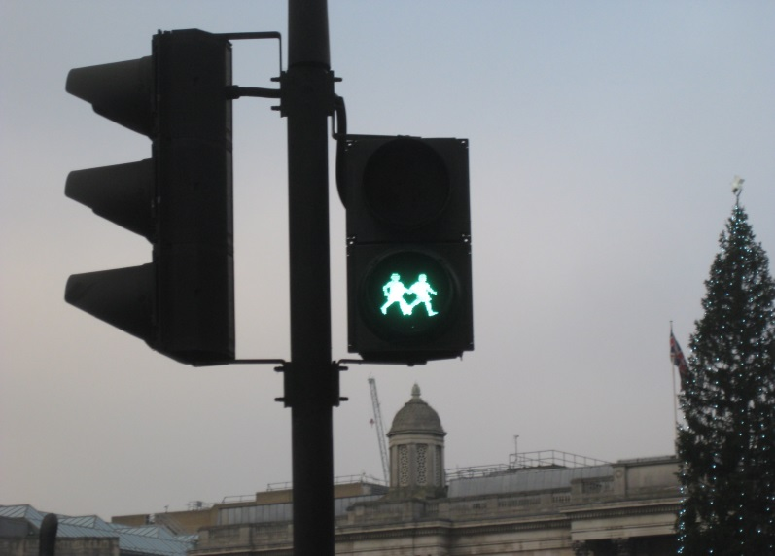
Green Light for Toilet Desegregation and Gender Neutral Toilets?
Who benefits and who loses out?
Are female and male toilet requirements really compatible?
The UK Gender Identity (Protected Characteristics) Bill and the US Title IX both stipulate that anyone who self-identifies as female can use the Ladies loos, not just the 5000 transgender women but potentially all and any men
In contrast at UN level, paragraph 2.1.2 of the UNICEF 2016 document, Core Questions and Indicators for Monitoring WASH in Schools in the Sustainable Development Goals, on applying Sustainability Development Goal 6 to toilet provision specifies that separate school toilets should always be provided for girls
And the United Nations Report 2014 on The Human Right to Safe Drinking Water and Sanitation states that gender-specific toilets should be provided because of issues of dignity and safety http://www.righttowater.info/tag/gender-equality/ and http://www.un.org/waterforlifedecade/human_right_to_water.shtml

Slide 23
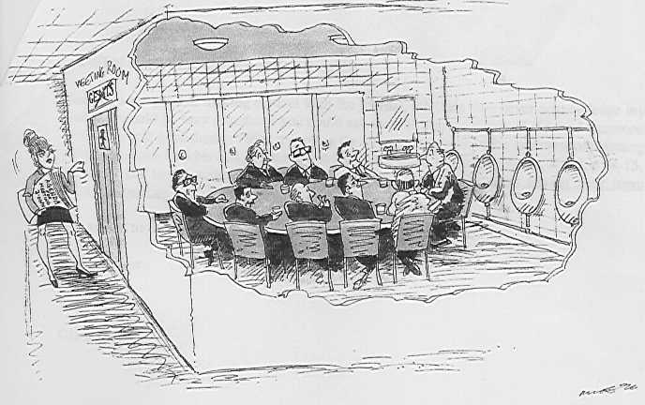
BUT WHO STILL MAKES THE TOILET DECISIONS IN THE UK?
(Courtesy of Haymarket journal publications)
Notes:
But who exactly are the people who make decisions about public toilet provision? Most provider groups tend to be men, including those at central and local government level, as well as in private sector toilet providers. But most of the campaigners, complainers and users are women.

Slide 24
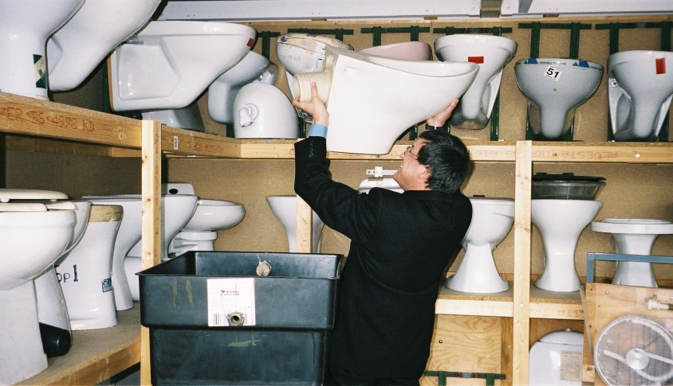
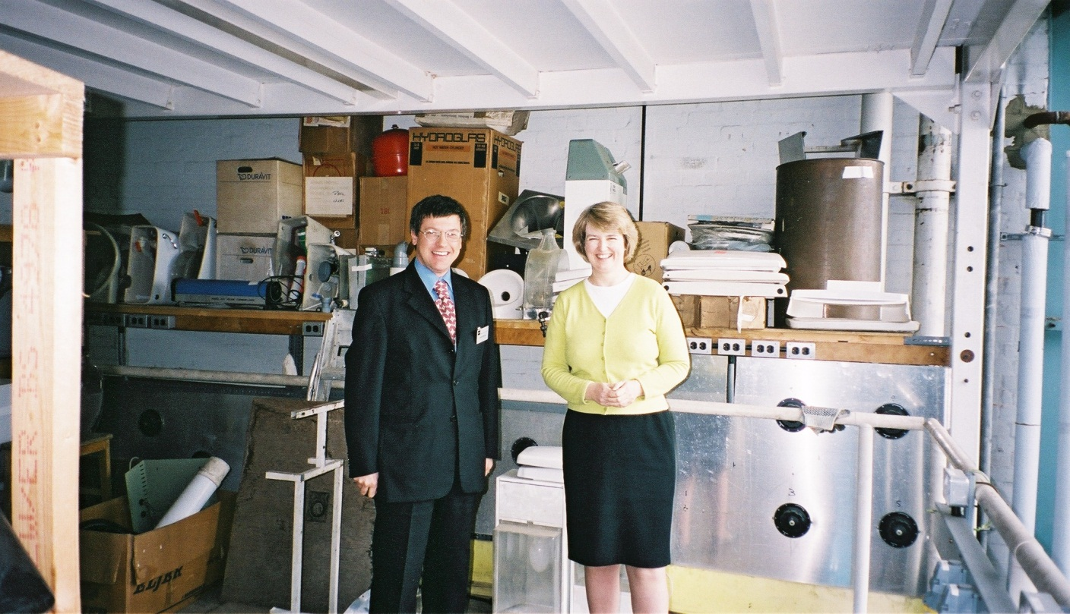
Meanwhile back in England, colleagues such as John Griggs, shown here at the Building Research Establishment, and Michelle Barkley, architect and fellow members of the British Standards Institute Committee on Sanitary Installations continue the toilet campaign for more equal and function al toilet provision for women.
What can you do? ‘talk toilets’, admit that menstruation exists. Campaign, lobby politicians, and if you want a rewarding career, go into engineering, construction or plumbing as this is the new revolutionary feminist frontier!

