Slide 1

Cwtsh with an ‘S’
Maindee Unlimited AGM
Notes:
Thank you to Aled for providing me with this opportunity to speak to you today

Slide 2
Welcome to Cwtsh with an ‘S’
Introduction
A brief history
What we do at Cwtsh
Plans for the future
Questions
Notes:
Cwtsh with an S – Presentation to Maindee Unlimited AGM - A

Slide 3
Cwtsh – a definition
A close hug. Originally a Welsh word which has been borrowed comfortably into the English dialect of south Wales.
Also from Welsh. A small cupboard or hut, such as an under-stairs cupboard or coal-shed
  "Come on, give me a cwtsh then!"
  "I saw them cwtshing in the park”
  "Get me the dust-pan from the cwtsh"
Notes:
A little first about why we call it Cwtsh; the Welsh speakers amongst you may have spotted that we spell Cwtsh with an H rather than a C . And there is a good reason! The word Cwtsh, meaning a small safe place, can of course be spent spelt in both ways, we chose to spell it in a way that we do in response to a simple expedient. The Internet domain name was available for Cwtsh.org!

Slide 4
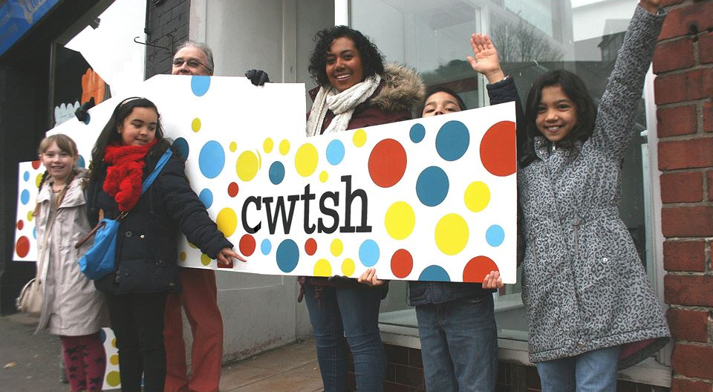
From Handpost to Cwtsh
Notes:
Before I tell you what we do at Cwtsh perhaps I can take a couple of minutes to tell you about our history. In 2014 Newport city council was obliged to make sweeping cuts to its budget–no change there are you say! One of the cuts that they made was to close Stow Hill library. This duly happened on March 31 2014 despite the efforts of local residents who came together in an active campaign to save the library from closure.

Slide 5
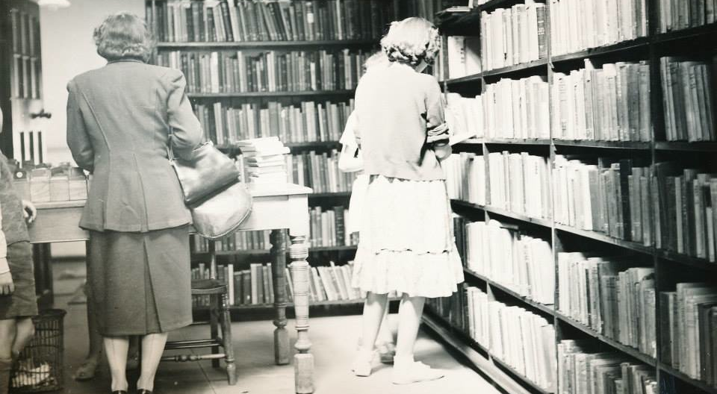
Stow Hill Library Closed
On the 31st of March 2014 Newport City Council finally closed the doors of the Stow Hill Library following a concerted fight by local library users

Slide 6
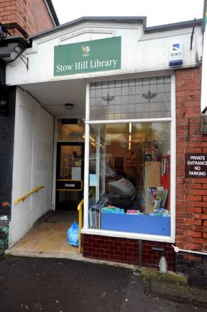
Stow Hill Library - resurrected?
Since that closure over the past 2 years a small group of enthusiasts have been thinking about how to bring life back into the recently closed Stow Hill Library.
This is what we have done
Notes:
We quickly realized that we could not simply be able to continue to operate the former library in the way that the local authority had done - we had no income stream. We would need to think about a new business model that had at its core the ability to generate sufficient income to cover even the modest overheads required to operate as a new library and arts centre.

Slide 7

What we have done......
We began by celebrating what the Stow Hill Library had meant to us and our community
We went on to realise that in a changing world new ways of promoting and enjoying reading might be needed.
Notes:
We quickly realized that we could not simply be able to continue to operate the former library in the way that the local authority had done - we had no income stream. We would need to think about a new business model that had at its core the ability to generate sufficient income to cover even the modest overheads required to operate as a new library and arts centre.

Slide 8
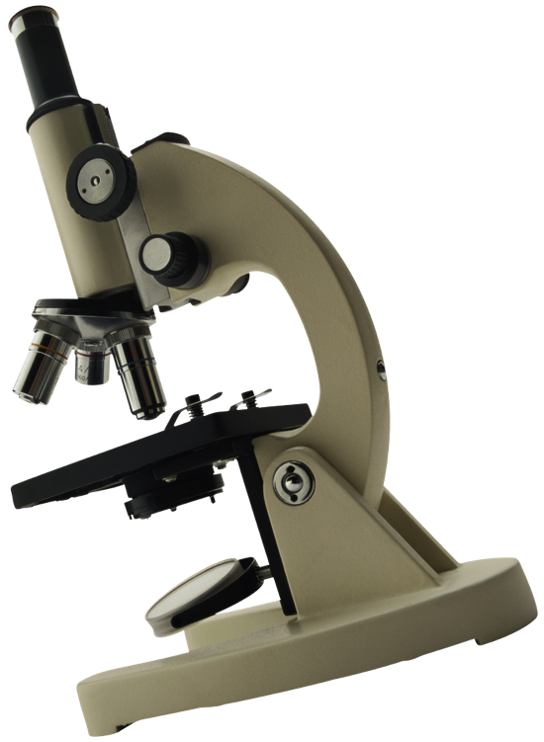
We did a lot of research
We focussed on some of the things that a new
Stow Hill Community Resource could provide
We did some ‘blue sky’ thinking
Notes:
We began by approaching the Council for a lease of the building; following protracted negotiations we finally settled on a reasonable, But still expensive figure on the agreement that we would be wholly responsible for repairing, upgrading and maintaining the building that would house our new community venture.

Slide 9

Visions for the future
Some ‘blue sky’ thinking
A local ‘micro’ library and resource centre that provides
access to a virtual library accessed online via the main City library service website
a real children's library and learning resources
A small venue for special interest groups
Painting - crafts
Languages
Hobbies
Films
A micro arts centre?

Slide 10
....more thoughts
A community and cultural resource: managed in partnership with its users with the aid of volunteers
A small space venue for:
  readings
  performances
  cinema club
  workshops
  Cafe

Slide 11
...... and yet more
With opportunities for:
  New ways of learning,
  social engagement,
  and access to new technology

Slide 12
Money, Money and building…..
Notes:
We then spent the next year raising the funds, preparing the plans and carrying out the work that would make our dream of creating a new community resource a reality. In all, we raised something like £16,000, the sum needed to completely refurbish the building.

Slide 13
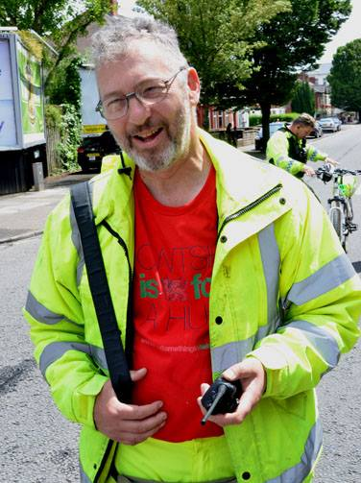
How we got our money?
First things to do – get yourselves a ‘John’ together with a small band of passionate enthusiasts who will
  Turn up
  Get creative & have vision
  Put their hands in their pocket
  Be inclusive and listen to their users

Slide 14
MONEY
Capital project phase
  Apply to local fund giving bodies e.g. The Church in Wales fund, the Monmouthshire Building Society for small grants
  Attract (and look after) individual ‘benefactors’
  Use what’s there – we used the Co-op movement to get free architectural and project planning advice
Revenue funding
  Create a sound business plan – make sure you have a professional in your approach
  Apply an appropriate ‘business model’ – people won’t pay for library membership but they will pay for room hire
  Aim for quality while keeping costs to a minimum

Slide 15
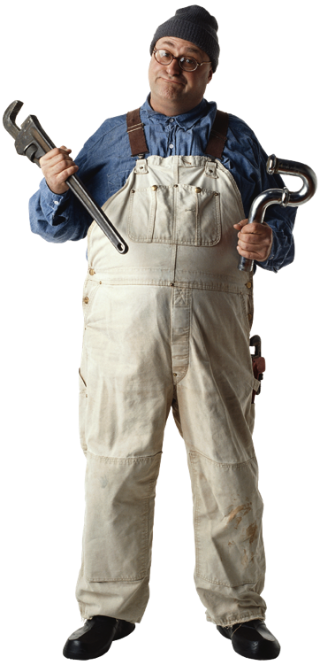
What we have achieved in the past three years
Registered as a charity
Developed a business plan and budget and a set of plans - raised the money and spent it wisely
Developed the policies and procedures that we needed to run a successful charity
Secured a 6 year lease with NCC
Opened a Facebook page - Cwtsh, a Twitter account, built a website www.cwtsh.org/home
Run regular ‘open mic’ poetry readings and other fundraising events
Created a partnership with the local school as an after school library
Become a sought after exhibition space
Notes:
We began by approaching the Council for a lease of the building; following protracted negotiations we finally settled on a reasonable, But still expensive figure on the agreement that we would be wholly responsible for repairing, upgrading and maintaining the building that would house our new community venture.

Slide 16
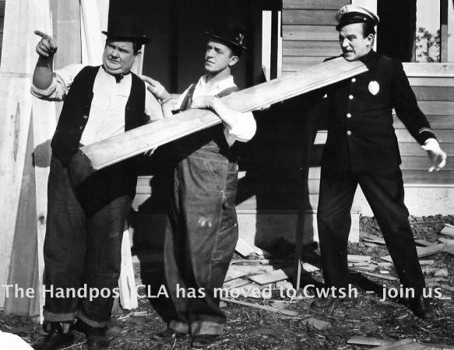
When we finally opened
Easter - 2015
Notes:
It was the Easter of 2015, just over a year since enclosed, that the new Community library and Arts Centre Cwtsh opened it’s doors.

Slide 17

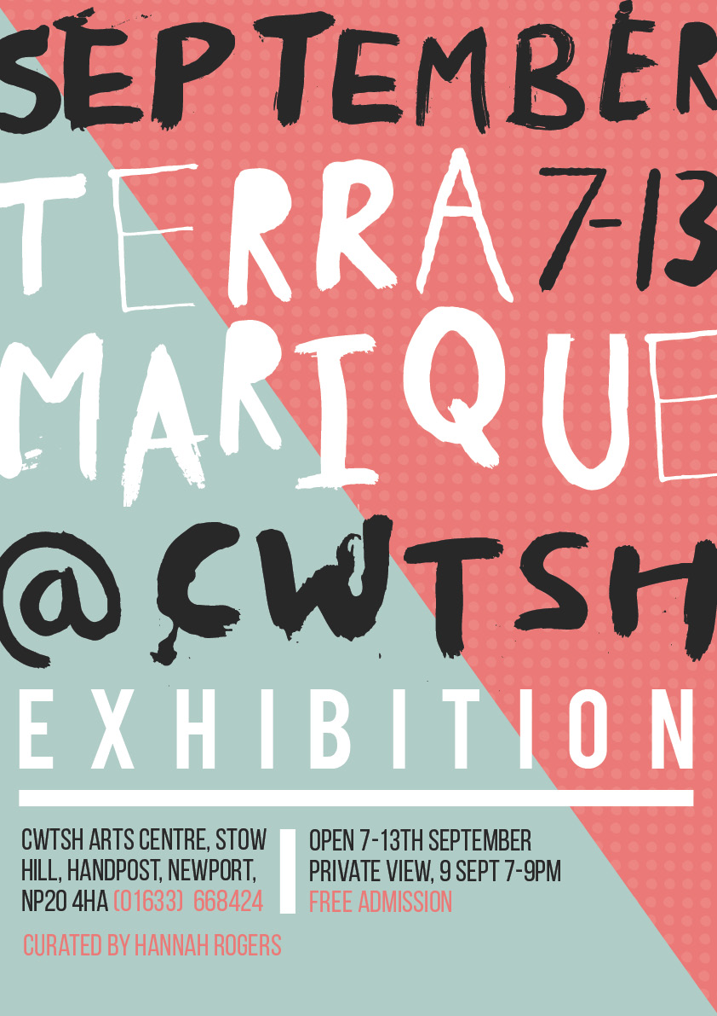
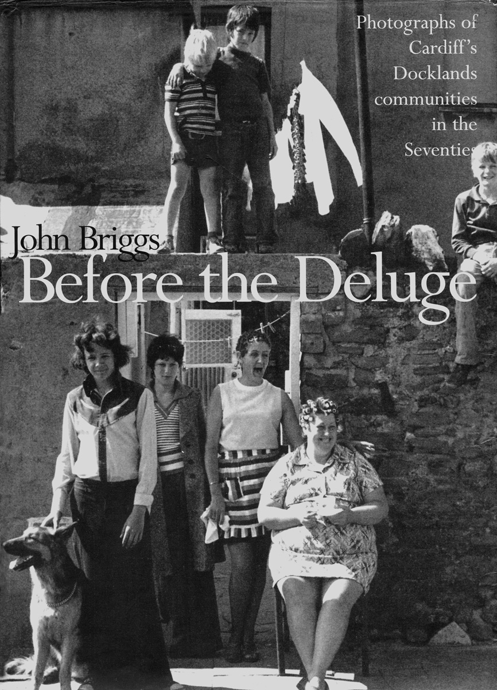
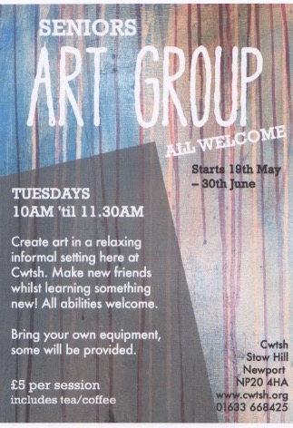
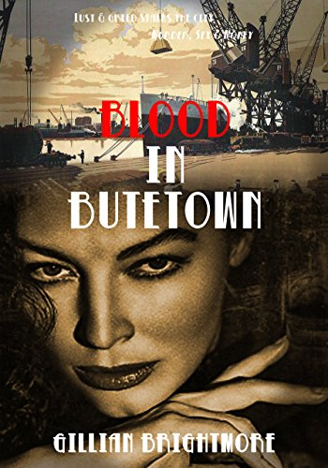
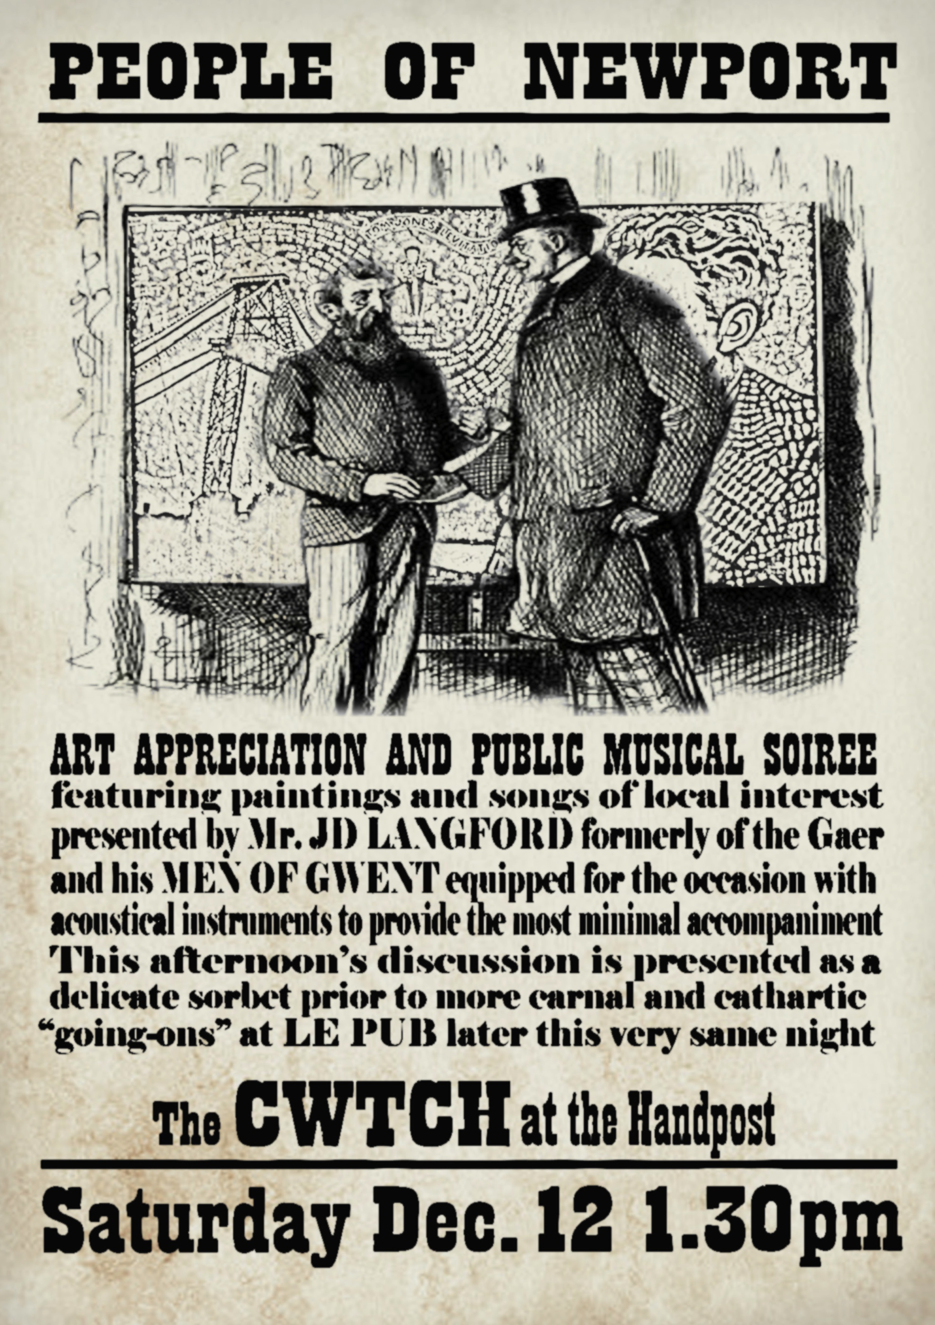

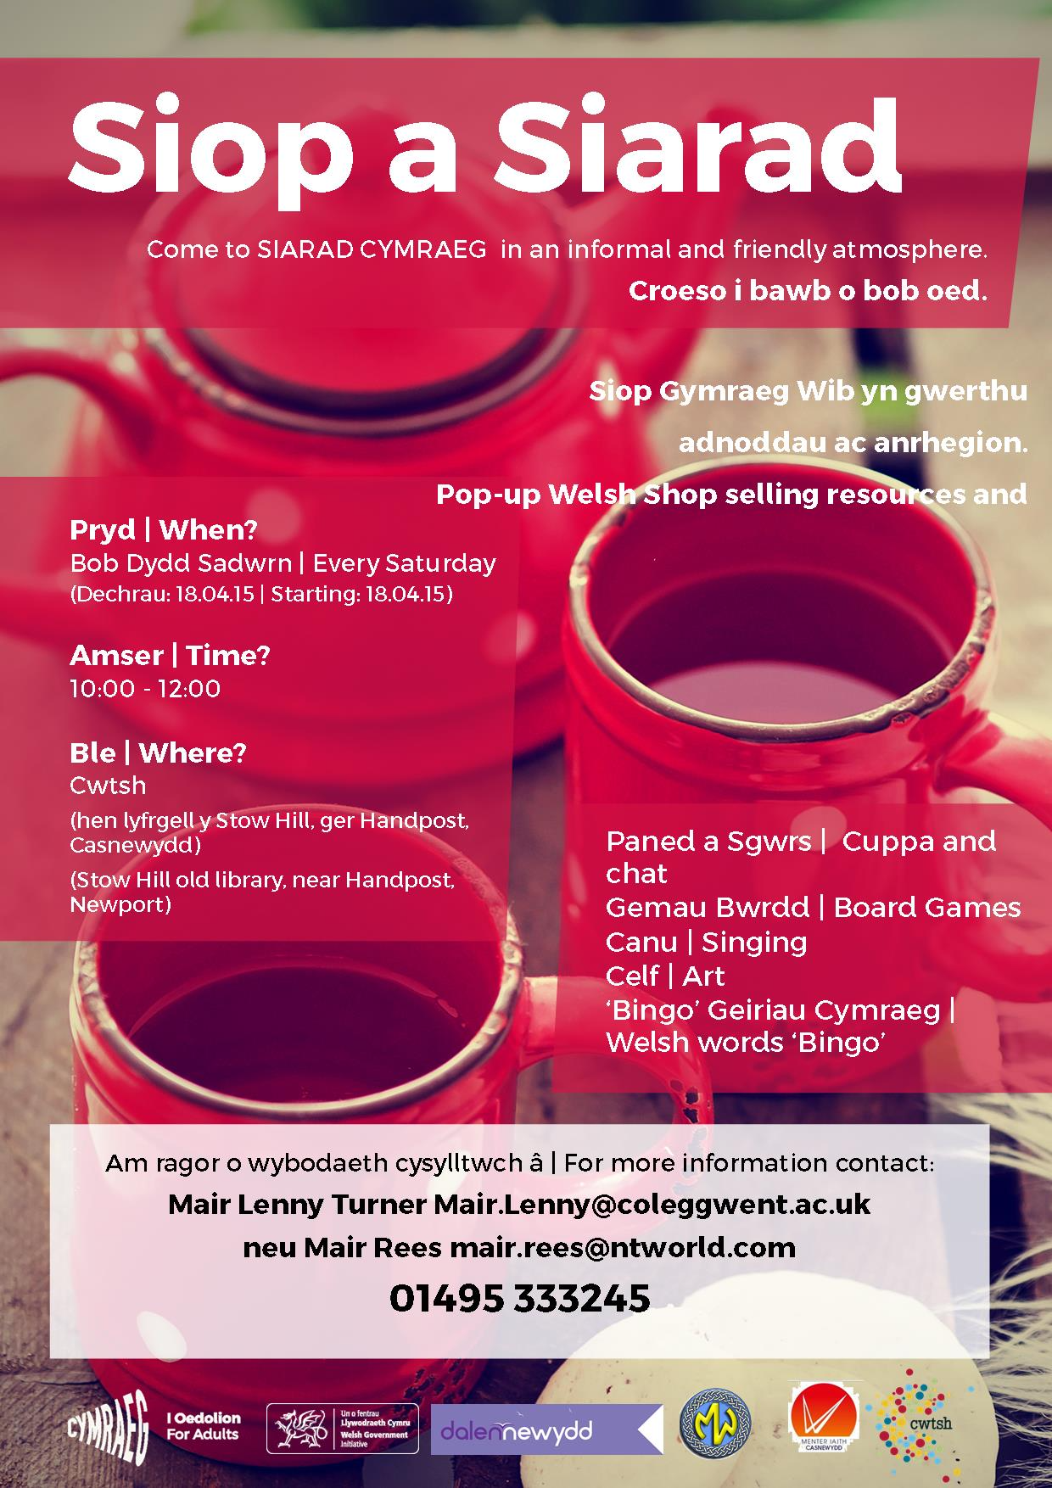
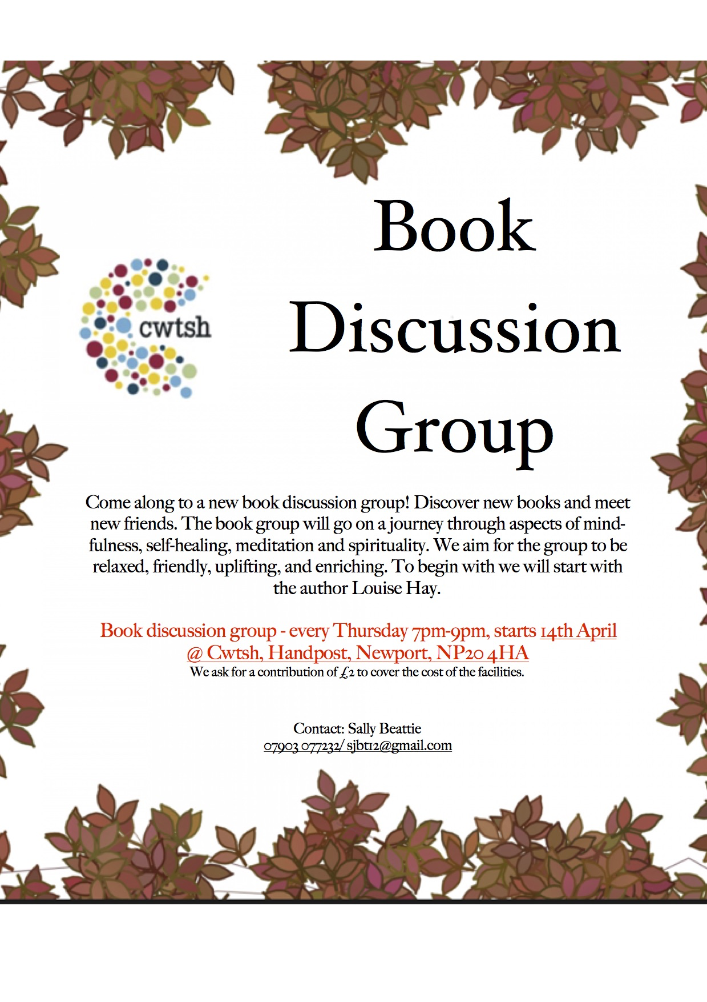
What we do?
Notes:
So what we do at Cwtsh? Having held a number of public meetings, curator’s events, volunteer open days as part of our research we had a pretty good idea about what those living in and around the Handpost area wanted – pretty well anything and everything.

Slide 18
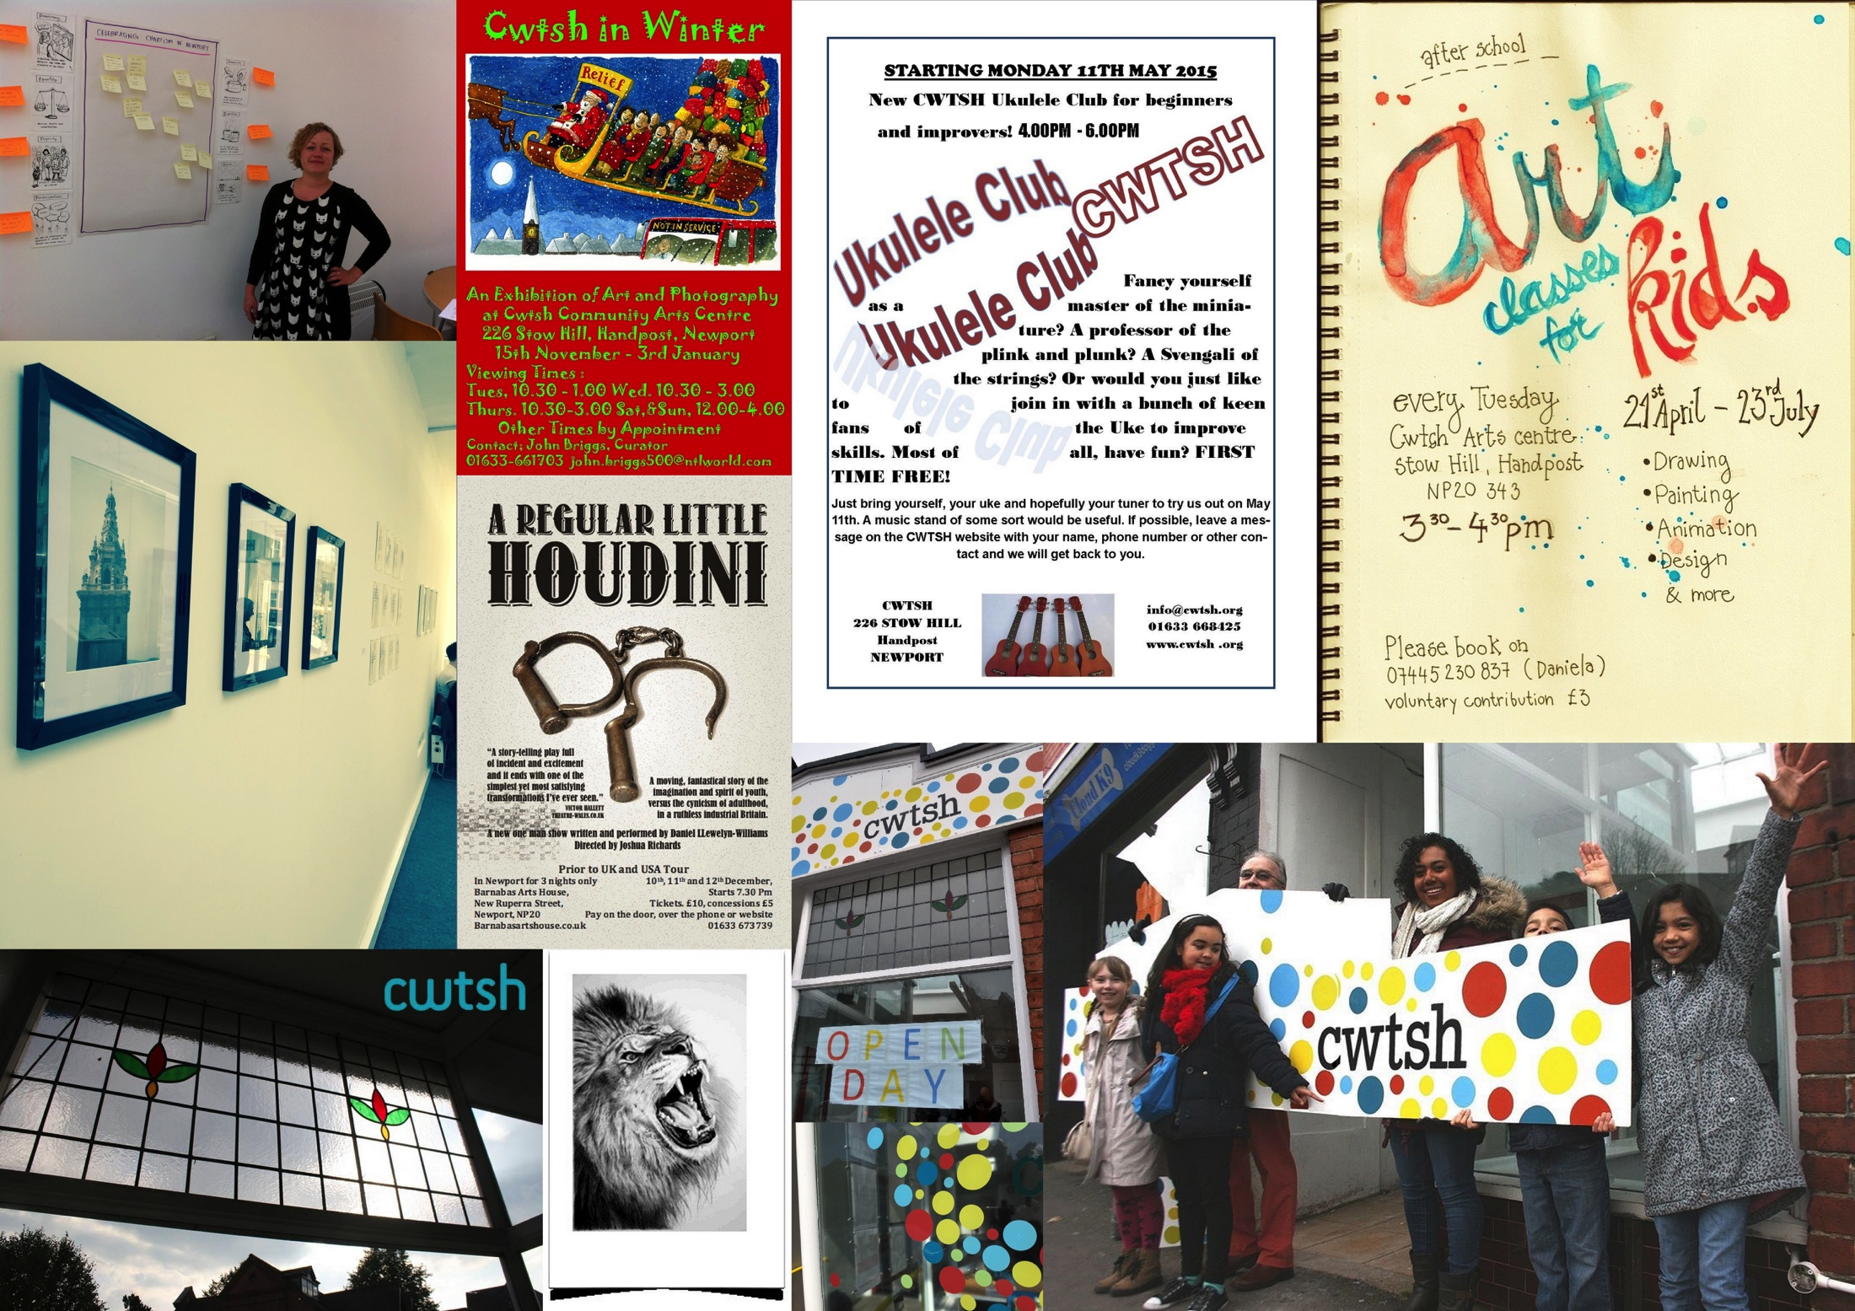
Notes:
We began with art classes for adults, a ‘Mindfulness’ group, Ukulele classes (thank you Greg Platt) a Creative Writing Group, after school Art classes for children, Welsh courses, a French conversation group and then a formal French language class, children’s library sessions. the Phoenix Film club, Sewing machine classes, A Friends and Neighbours (FAN) group

Slide 19
How to find out more about what we do at Cwtsh
Email – info@cwtsh.org
Website – www.cwtsh.org
Facebook Page: https://www.facebook.com/Cwtsh-717947234884956/

Slide 20
Thank you and
Any Questions?

