Slide 1


Slide 2
Some words that crop up…
GOVERNANCE
GOVERNING DOCUMENT
BENEFICIARIES
CHARITABLE OBJECTS
VISION
RESOURCES + RISKS

Slide 3
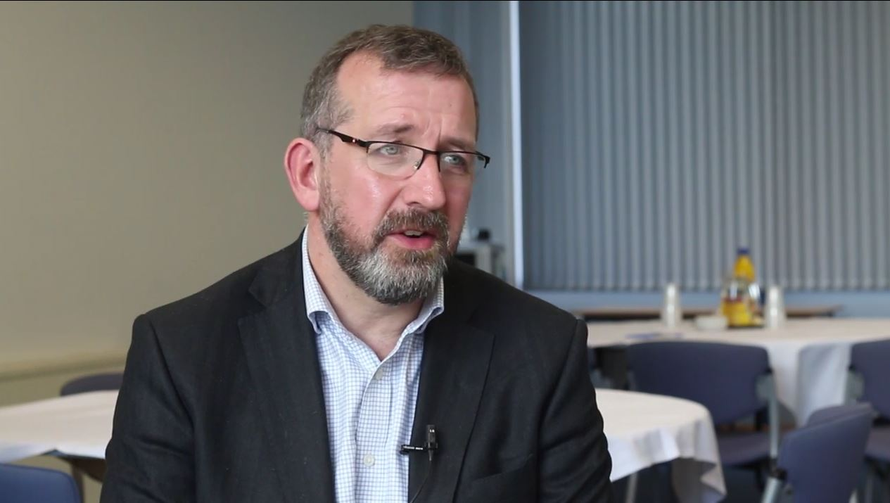
Advice to first-time Trustees

Slide 4
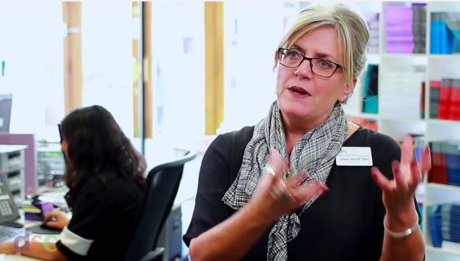
What is good governance?

Slide 5
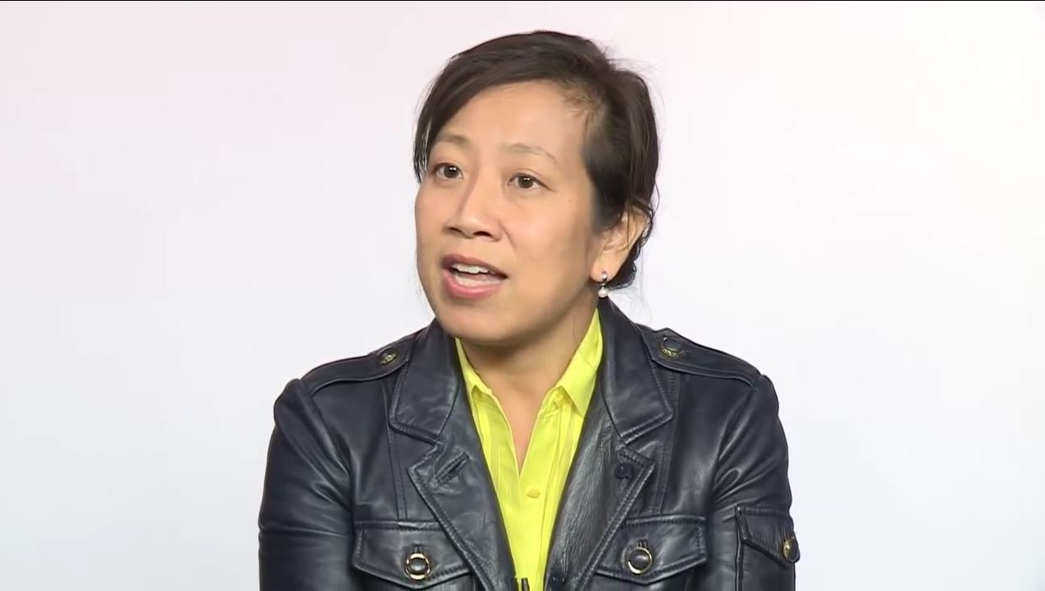
Typical Board challenges

Slide 6
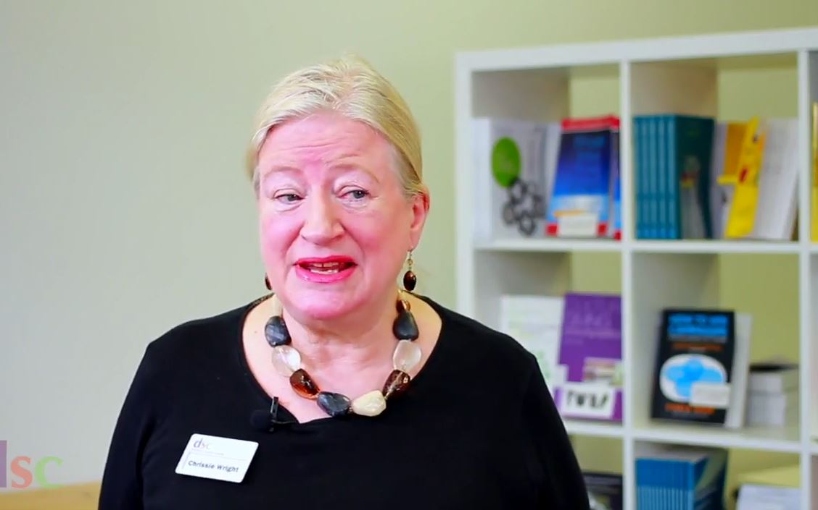
Your personal development as a Trustee

Slide 7

Charity Commission Code

Slide 8
to transform Maindee into a sustainable community with a strong local identity, strong local economy and a reputation as an attractive, safe, culturally vibrant and cohesive place to live, work and relax.

Slide 9
RESOURCES:
Volunteers
Library lease
Money
Social capital
Partners
Staff
RISKS:
Cash flow
Buildings
Reputation
Equipment
Public liability
Staff liability

