Slide 1

Fire Safety
Llyfrgell Maindee Library
79 Chepstow Road
Newport NP19 8BY

Slide 2
What to do if you discover or suspect a large fire
Activate the fire alarm.
Telephone 999 to call the fire and rescue service
Start evacuating the building - assist people who are frail.
Close doors to confine the fire.
Move to the assembly area on Chepstow Road (or Police Station car park if fire is blocking main entrance). Stay upwind of the fire
Have someone who knows the location of the fire help emergency crew when they arrive.

Slide 3
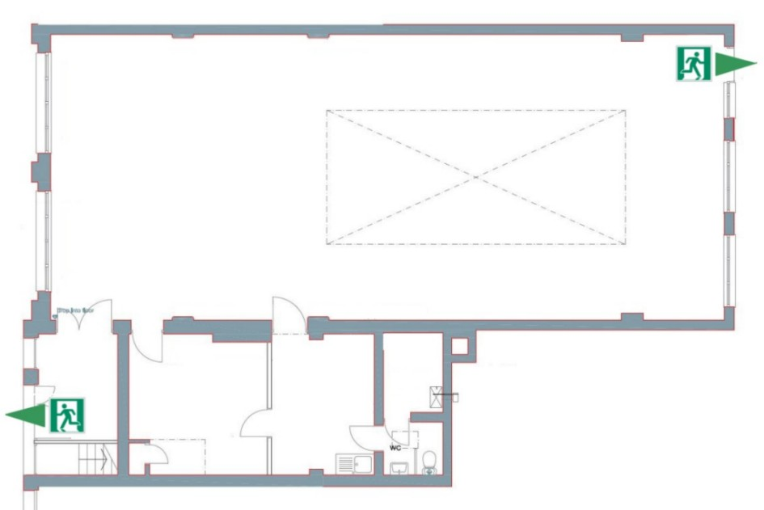
FIRE EXITS
(1) out onto Chepstow Rd
(2) into police car park
Use (1) unless
blocked
If you are inside with the front door locked – leave the key in the lock
When the library is open the outer front door should always be hooked open

Slide 4
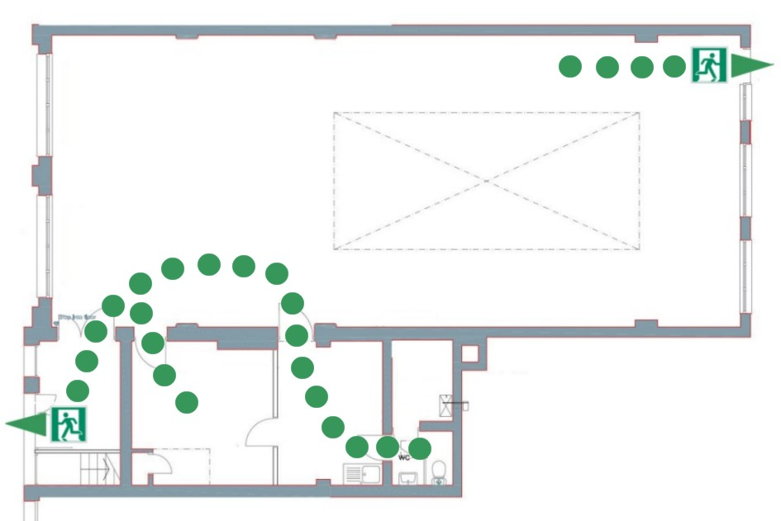
FIRE EXITS
Always keep these main routes to
exits clear
Nothing should block a safe
exit from the building
Don’t let the lobby fill up with paper and card – keep it clear of inflammable waste
Check the rear exit is never blocked

Slide 5
Calling the Fire and Rescue Service – dial 999
Don't be afraid to dial the fire service even if you're not sure if there is a fire
Call 999 from the library phone or your mobile
Don't think that someone else must have already rung
Call 999, no matter how small the fire

Slide 6
What to do if you discover a small fire
Activate the fire alarm.
Telephone 999 to call the fire and rescue service
Start evacuating the building - assist people who are frail
If you know how to use a fire extinguisher, and have a clear exit path behind you, bring the extinguisher to 10 feet from the fire.
Use the P-A-S-S procedure to use a fire extinguisher.

Slide 7
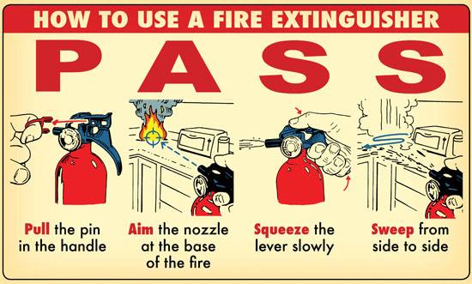
What to do if you discover a small fire
Activate the fire alarm.
Telephone 999 to call the fire and rescue service
Start evacuating the building - assist people who are frail / disabled.
If you know how to use a fire extinguisher, and have a clear exit path behind you, bring the extinguisher to 10 feet from the fire.
Use the P-A-S-S procedure to use a fire extinguisher.

Slide 8
Fire Extinguisher Tips
The ring pulls can be stiff - you may need to pull hard
Stand between the fire and your fire exit – not the other way round or you might get trapped by the fire.
Do not stand over the fire when using an extinguisher - 10 ft (3 metres) away is a better and safer distance to work from.
Don’t use water on an electrical fire – water is a conductor!
Never hold the nozzle of a CO2 exstinguisher – it’s freezing!

Slide 9
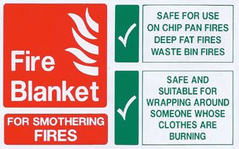
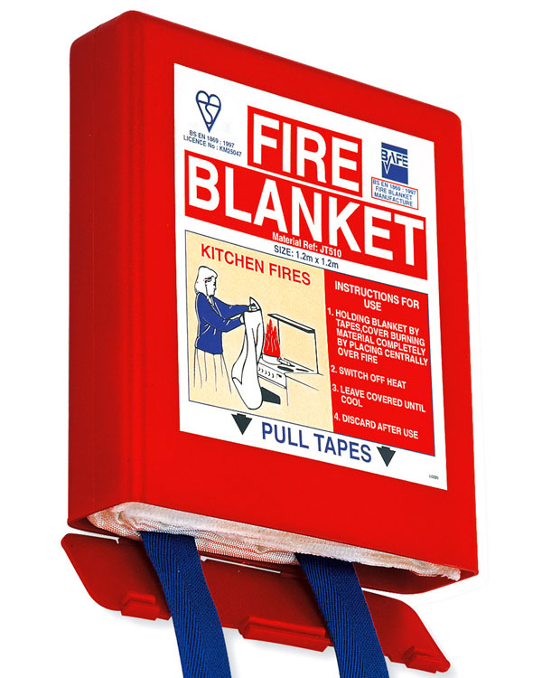

Slide 10
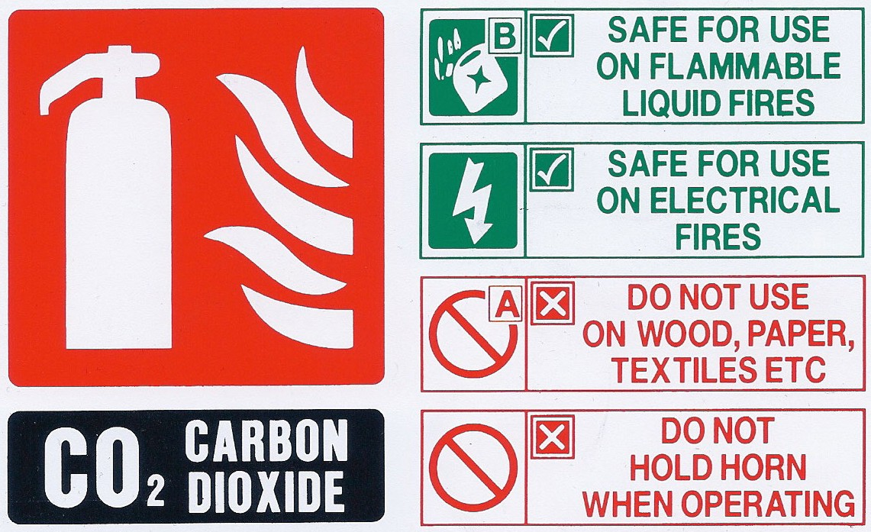
WHY

Slide 11
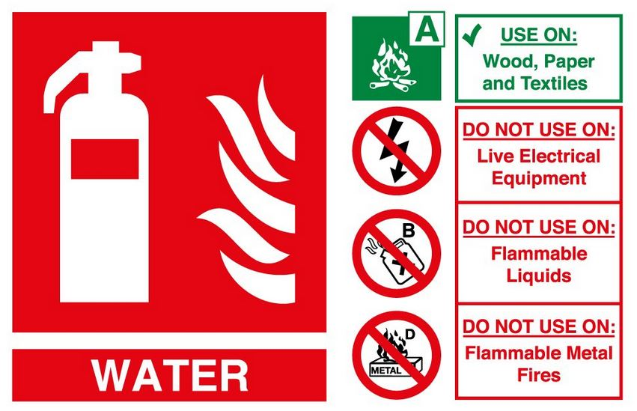

Slide 12
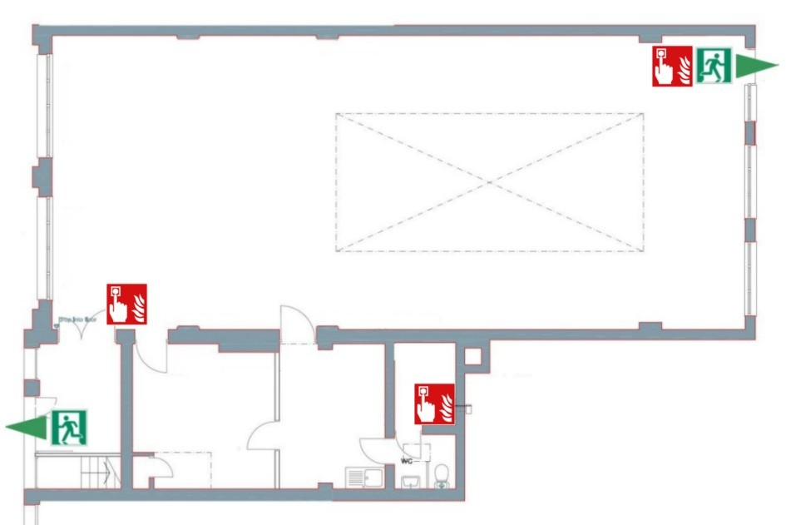
ALARMS
There are three “break glass” points.
Press glass
firmly to set off
fire alarm

Slide 13
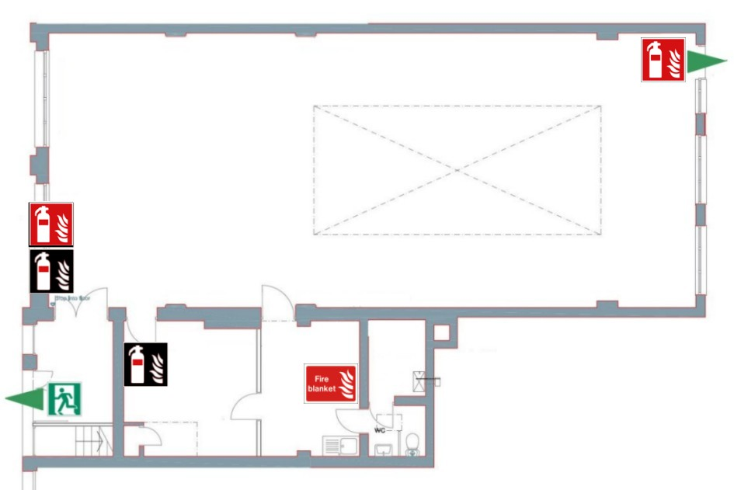
FIRE EXTINGUISHERS
There are
three types of
extinguishers…
…for different
types of fires
WATER
CARBON DIOXIDE (CO2)
FIRE BLANKET

Slide 14
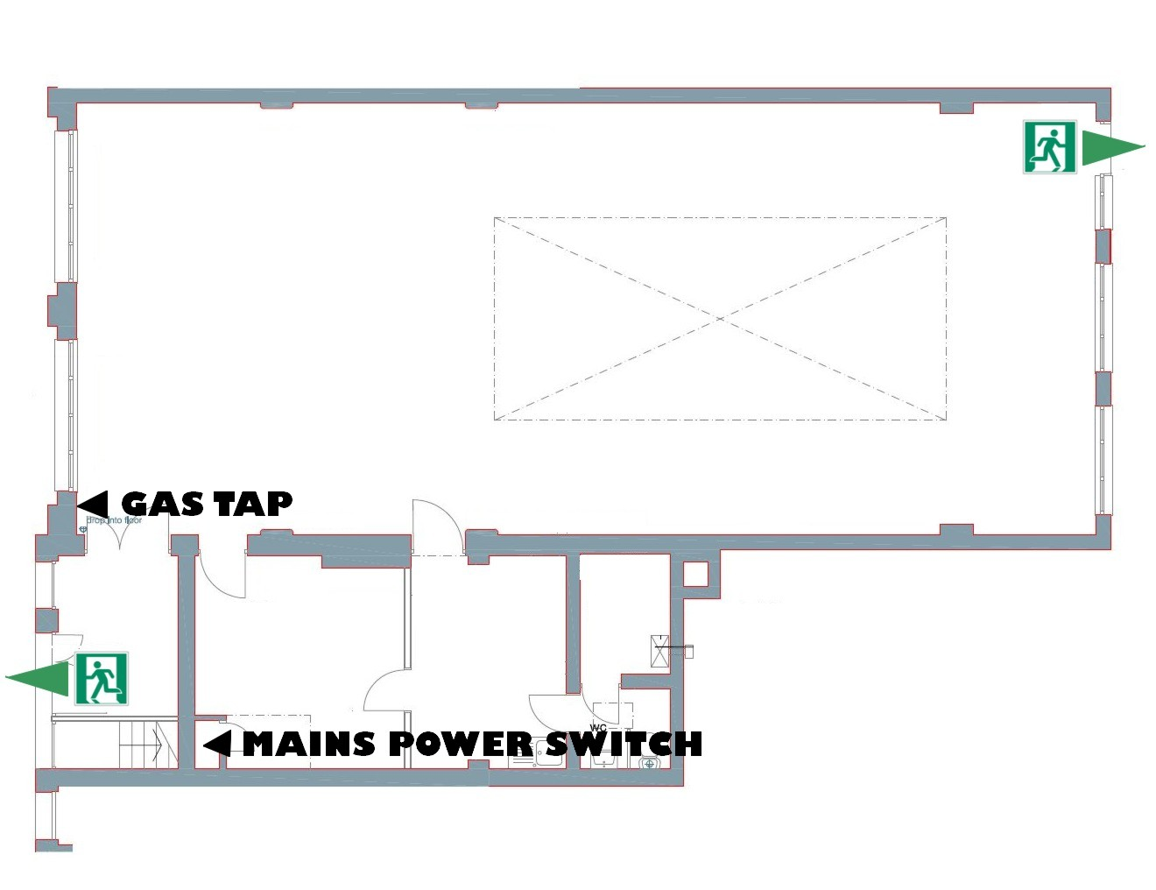
GAS
The gas tap is in a
wall cupboard in the
corner of the library by
the door to the lobby
ELECTRICITY
The mains switch is in
the cupboard in the
corner of the small
Meeting room

Slide 15
Fire safety awareness
Never allow smoking in the library
Keep fire exit routes clear
Empty waste paper bins each day
Report any risks or near misses and record then in the incident book.

